Slide 1
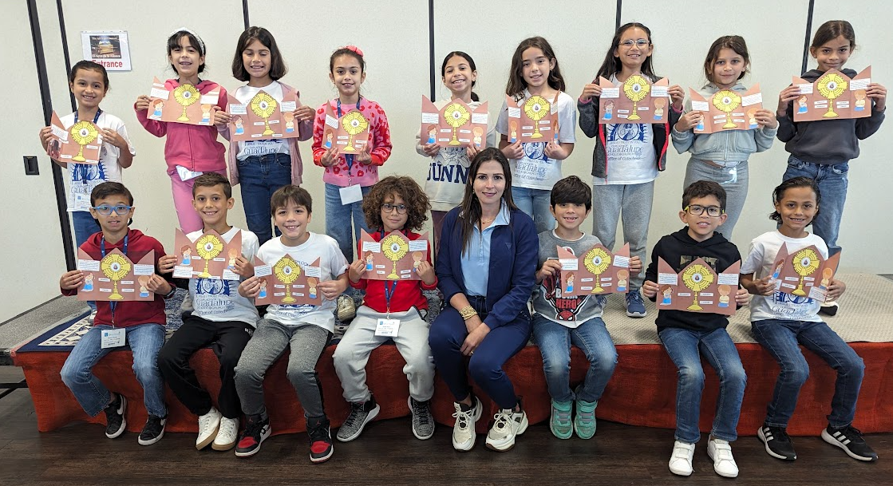


Welcome to the
2025-2026
Catechetical Year
Open House
For FC 2
2nd Level / 2nd Year
Parish WhatsApp # 786-309-3387 (only WhatsApp, no calls)
Parish E-Mail: Miguel.ruiz@guadalupedoral.org
Parish Website: www.guadalupedoral.info
Mark your Attendance
https://guadalupedoral.info/open-house/

Slide 2

Special Points
To better understand the Program

Slide 3
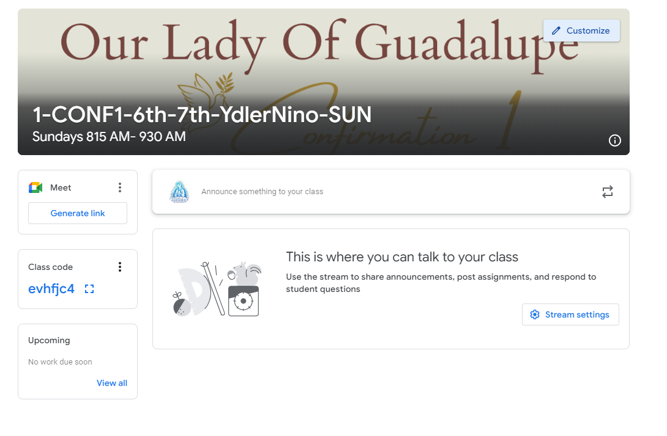
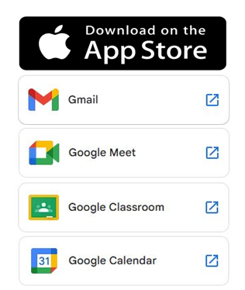
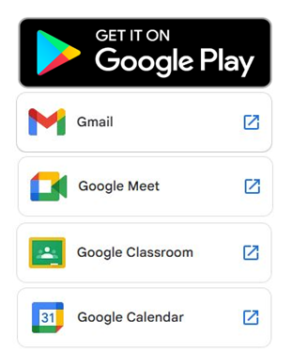
Google Classroom
We will use the Google Classroom as a method of communication. Please log to your Google Classroom account every Friday or Saturday to see any news
Usaremos Google Classroom como metodo de comunicacion. Por favor visiten su cuenta de Google Classroom todos los Viernes o Sabados para ver si hay alguna noticia
GOOGLE CLASSROOM
Login with your parish email / Haga login con el e-mail de la parroquia
a. Username: name.lastname@guadalupedoral.org
b. Password: ****** (the one you selected – el que uds. seleccionaron)
The email account and the google classroom account have the same password / El Email de la parroquia y el google classroom tiene el mismo password
https://classroom.google.com/u/0/h

Slide 4

Parent’s Handbook
Por favor leerlo
Please read it
http://guadalupedoral.info/forparents/parent-handbook/

Slide 5
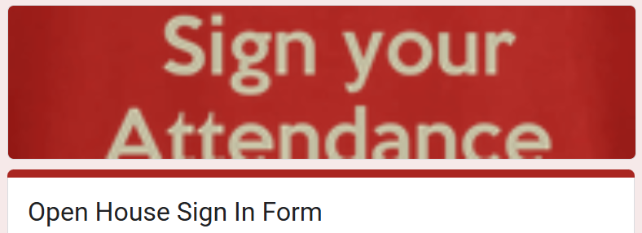
I have watched this Open House Video

Slide 6

Asistencia a Misa
Obligatoria porque Jesús lo manda en el 3er Mandamiento
Mass Attendance: Mandatory because Jesus says so in the 3rd Commandment.
Keep holy the Lord’s day is the 3rd Commandment
We must attend Mass every Sunday.
We must attend Mass in Person
In our Parish of Guadalupe
Or in any Catholic Parish
MASS ATTENDANCE LOG
Watch this Video/Vean este Video
https://guadalupedoral.info/mass-attendance-log/
You will get these messages every week through your Google Classroom
Recibirán estos mensajes semanalmente en Google Classroom

Slide 7
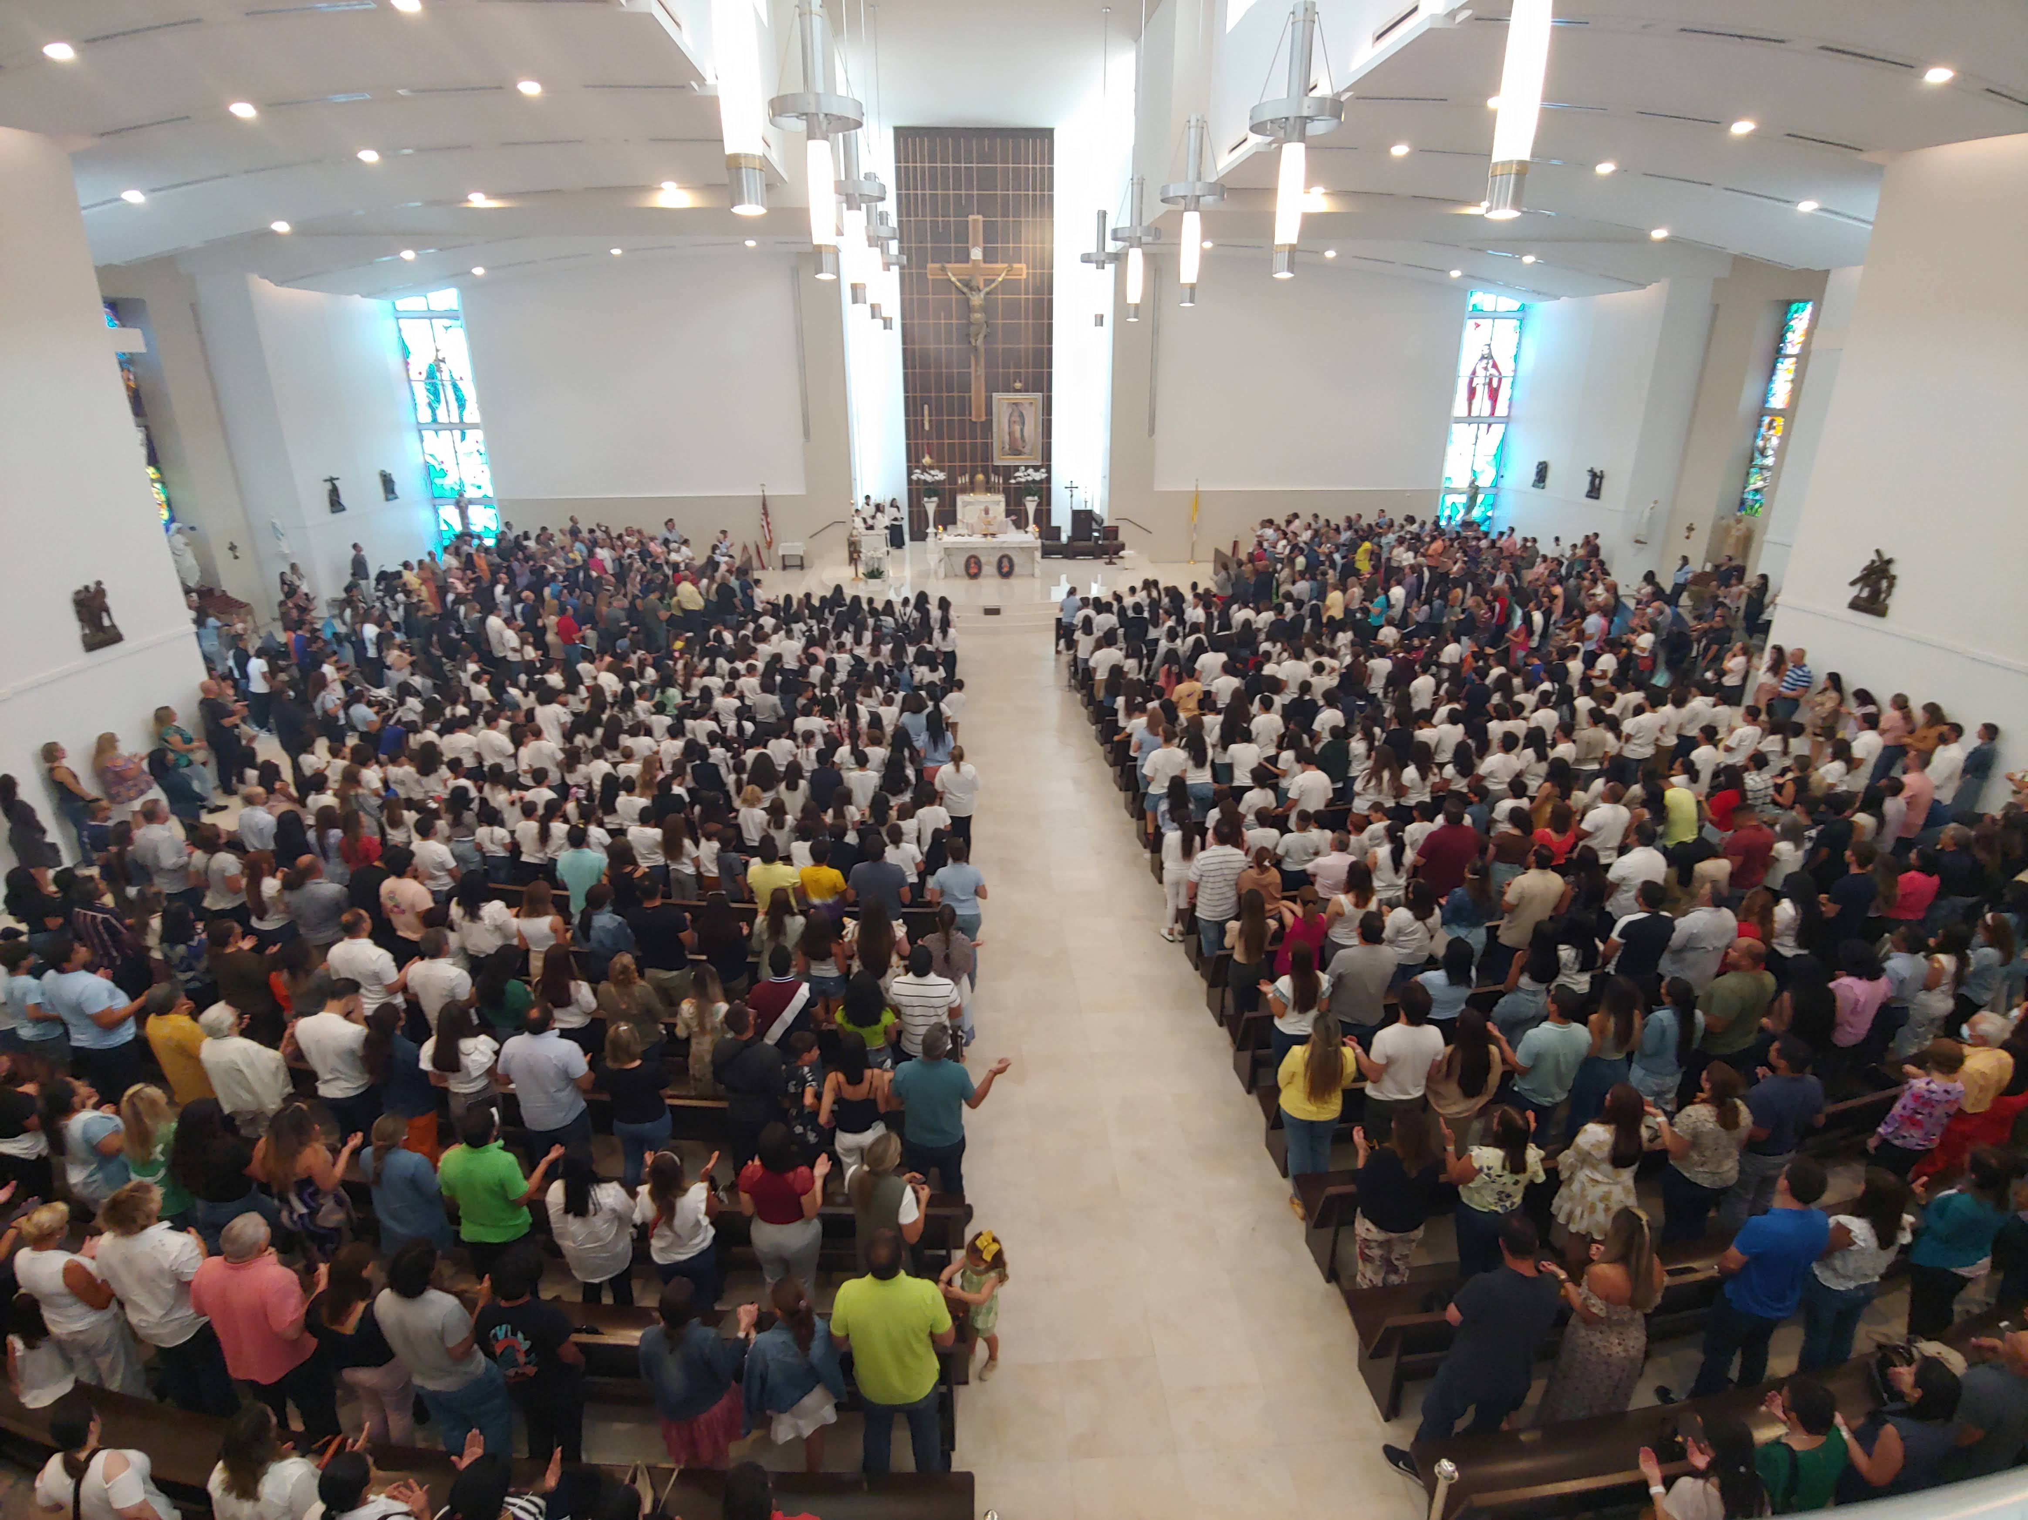
First Mass and Blessing for all our Students
Saturday 09/14 | 5:30 pm | English
 | 7:00 pm | Español
Sunday 09/15 | 8:30 am | English
 | 10:00 am | Español
 | 11:45 am | English
 | 1:30 pm | Español
 | 7:00 pm | Español

Slide 8
First day of Classes for kids and parents
CCD/RCIA First day of Classes & Locations in Our Lady of Guadalupe Church The First Day at least one Adult must stay with the Students (1st grade to 12th grade)
SUNDAY for all Students (Kids, Teens & Adults) enrolled in Classes at Doral Academy High School (11100 NW 27th St, Doral, FL 33172) * Communion Students (FC1 & FC2): September 14th * Confirmation Students (CONF1 & CONF2): September 14th * Special Need & Baptism: September 14th * Adults English Candidates: September 14th
MONDAY for all Students enrolled in Classes at Shelton Academy (9455 NW 40th Street Rd, Doral, FL 33178) * Communion Students (FC1) Students: September 15th
MONDAY for all Students (Young Adults & Adults) enrolled in RCIA Classes at Parish Hall (11691 NW 25th Street, Doral, 33172) * Young Adults Candidates: September 15th * Adults Candidates: September 15th
TUESDAY for all Students enrolled in Classes at Shelton Academy (9455 NW 40th Street Rd, Doral, FL 33178) * Communion Students (FC1): September 16th * Confirmation Students (CONF1): September 16th
5. WEDNESDAY for all Students enrolled in Classes at Shelton Academy (9455 NW 40th Street Rd, Doral, FL 33178) * Communion Students (FC2): September 17th * Confirmation Students (CONF2): September 17th

Slide 9
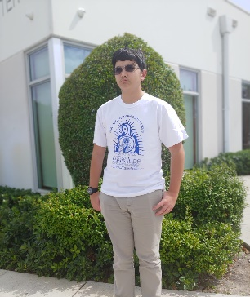
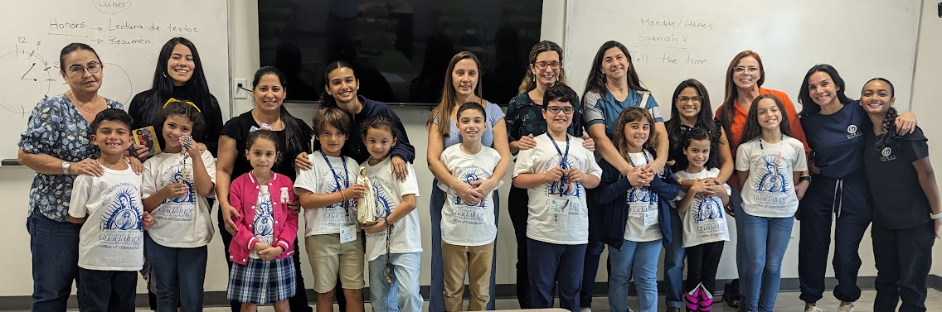
Uniform
Blue, Kaki or Jeans pants or skirts
Our Lady of Guadalupe T-Shirt
ID Tag

Slide 10
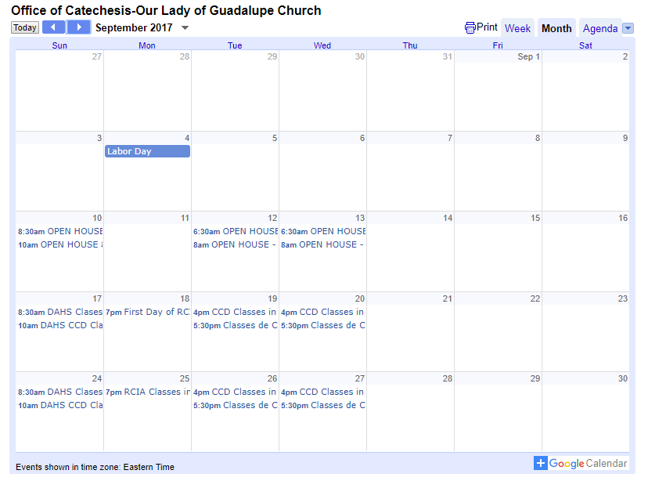
Calendario / Calendar
From your cellphone subscribe to our calendar by clicking over the +Google Calendar Icon that is at the bottom right corner of the online calendar and follow the instructions.
You might need to download the Google Calendar application.
Desde su celular suscríbase a nuestro calendario haciendo click sobre el +Google Calendar que está en la esquina inferior derecha del calendario electrónico y siga las instrucciones.
Tal vez tenga que bajar la aplicación Google Calendar.
The Official Calendar is posted in our website
http://guadalupedoral.info/calendar/ and download the Calendar
2025-2026
CCD Calendar

Slide 11
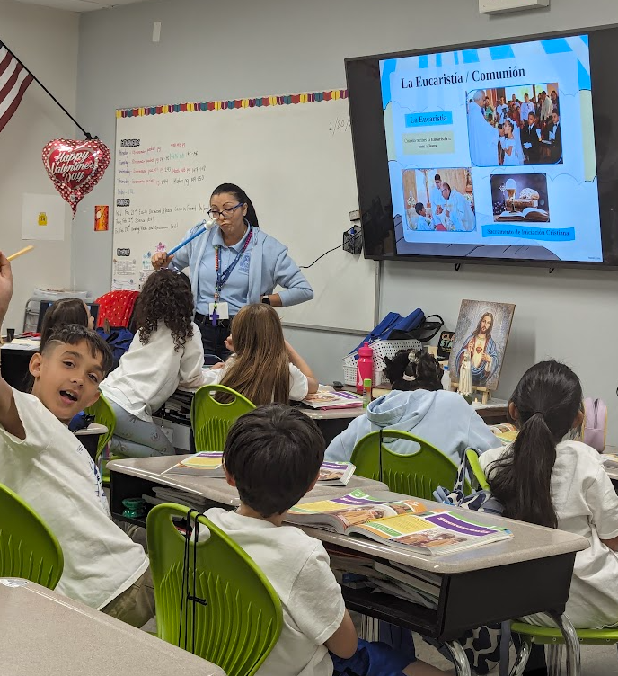


Class Attendance
1) Deben asistir a todas las clases
We must take our children to class.
2) MAXIMUM OF ABSENCES: Se puede faltar hasta 4 veces
They may be absent up to 4 times in a year
3) EXCUSE ABSENCE: Se debe enviar por e-mail el justificativo de la inasistencia. Se debe notificar al catequista y a la Oficina de la Parroquia.You must send via e-mail a Justification Note to your catechist and to the Office of Catechesis (ccd@guadalupedoral.org) & (your catechist e-mail) Sports practice, dance class, etc. are not considered Excused Absences. Las prácticas deportivas, las clases de baile, etc., no se consideran faltas justificables
4) NO LATE ARRIVAL: LOS NINOS DEBEN ESTAR SENTADOS AL MOMENTO DE COMENZAR, LA CLASE, Si llegan tarde no podrán ingresar al salón. STUDENTS MUST BE AT THEIR DESK ON TIME, if they arrive late, they will NOT be able to enter in the classroom
5) NO EARLY RELEASE: Students are not permitted to leave class early except in emergency situations. Sports practice, dance class, etc. are not considered emergencies. No se permite a los estudiantes salir de clase antes de tiempo, excepto en situaciones de emergencia. Las prácticas deportivas, las clases de baile, etc., no se consideran emergencias
Check your catechist Email in this link www.guadalupedoral.info/forcatechists/our-team/

Slide 12


Material/ School Supplies
For elementary school students
1- A composition notebook
2- Pencil case, zippered
3- A box of Crayons
4- Pair of blunt scissors
5- A sharpened pencil and an erase
6 A jumbo glue stick
7- 1 reams of paper - A DONATION (if you can)
For middle and high school students & RCIA
A composition notebook
A sharpened pencil, a pen, and an eraser
1 reams of paper - A DONATION (if you can)

Slide 13
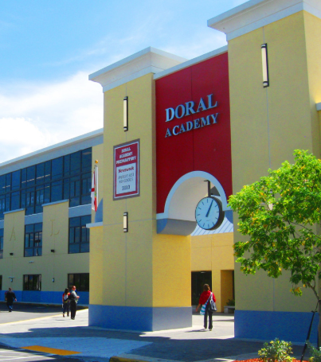
Special Points
To those attending Classes at Doral Academy HS
11100 NW 27 Street, Doral, Fl 33178
Sundays / Domingos 8:15-9:30 AM en Espanol 10:00-11:15 AM in English

Slide 14

Classes of Formation for Parents
This year we will provide Classes of Catholic Formation for Parents.
Classes will be given at the same time than the kids’ classes. Este año brindaremos Clases de Formación Católica para Padres.
Las clases se darán al mismo tiempo que las clases de los niños.
We will notify you as soon as we have the schedule

Slide 15

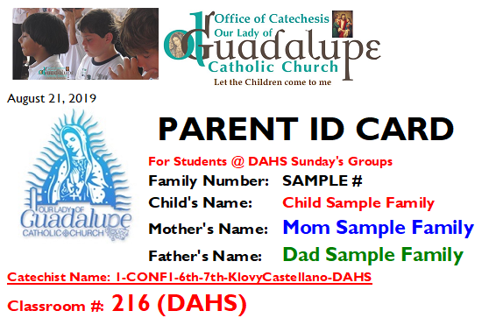
Pick up Parents’ ID for DAHS
For Students @ DAHS We will send it via email, so you show it to your catechist at the moment of picking up your child from the classroom. Please keep it in your Phone

Slide 16
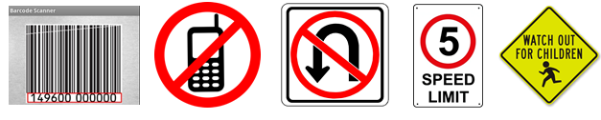
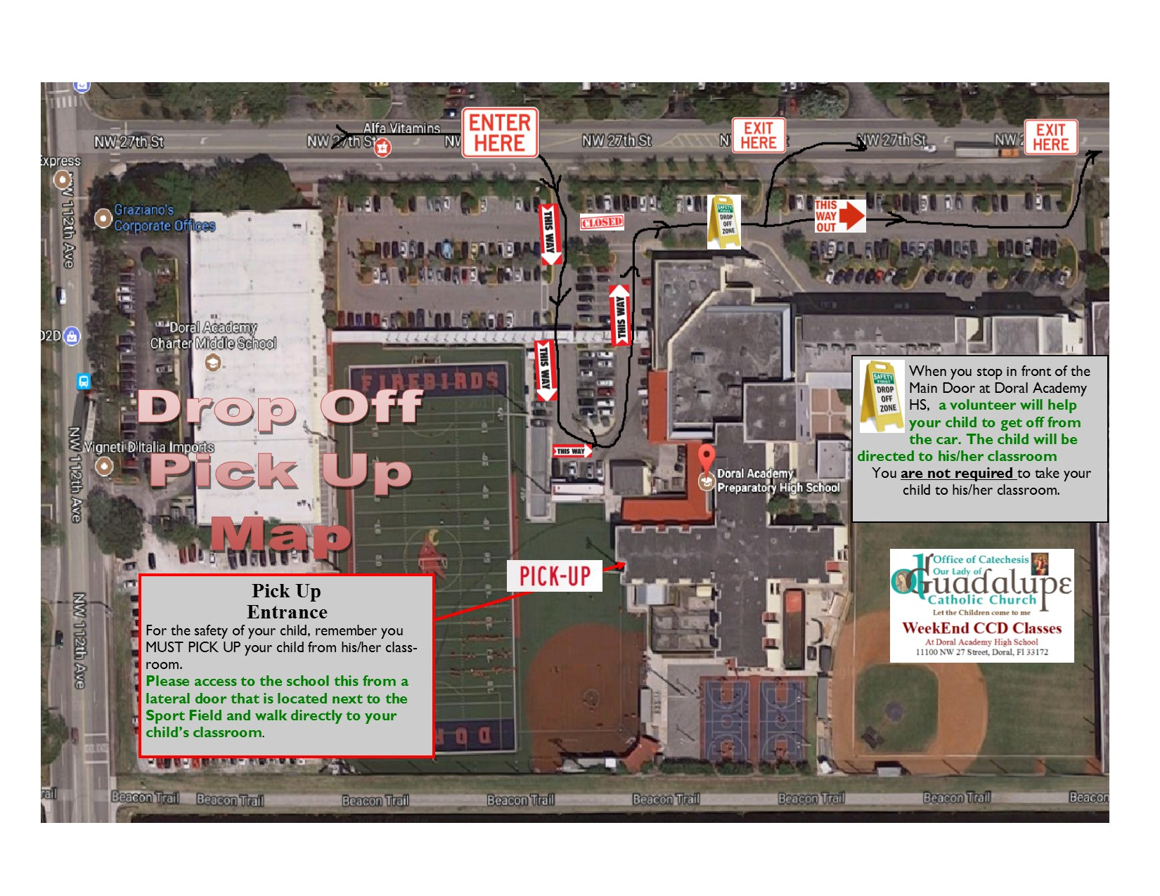
Drop off and Pick up AT DORAL ACADEMY HIGH SCHOOL on Sundays
Please do not drop students in the Street (at 27th). It is prohibited for safety reasons. / Por favor no deje a sus hijos en la Calle (27th). Está prohibido por seguridad.
You must take your child to the classroom. / Ud. Debe dejar a su hijo en el salon.
You MUST pick up your child from the Classroom / Ud. DEBE recoger a su hijo del salón
Only 6th graders and older with the Written Parents Consent may leave the classroom by themselves, but cannot leave the school, you need to pick them up. / Solo jóvenes en 6to grado para arriba pueden salir del salón solos, siempre que tengamos su Permiso por escrito, pero ellos no pueden irse de la escuela solos, uds. deben recogerlos. (YOU WILL RECEIVE IT IN YOUR GOOGLE CLASSROOM)
Please be kind and keep calm during the drop off and pick up time. / Por favor sea amable y mantenga la paciencia durante la entrada y salida.

Slide 17
Drop off and Pick up AT DORAL ACADEMY HIGH SCHOOL on Sundays

Slide 18
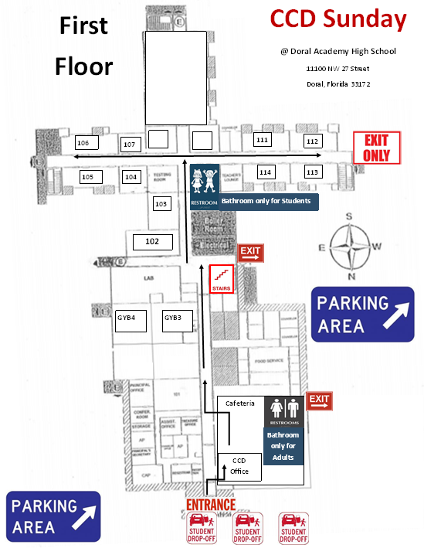
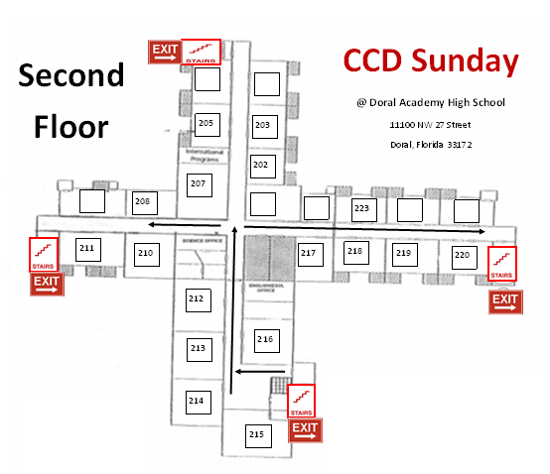
Classrooms @ DAHS

Slide 19
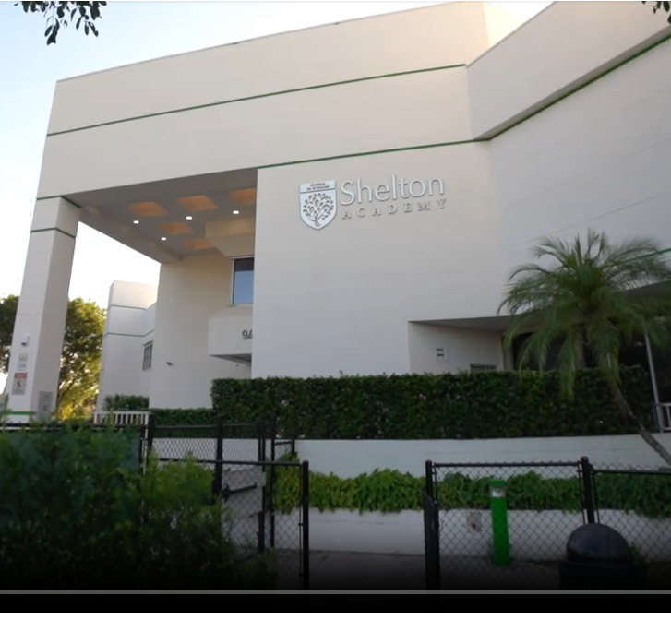
Special Points
To those attending Classes at Shelton Academy
Lunes 5:20-6:30 PM en Espanol
Tuesday/Martes 4:20-5:30 PM in English 5:50-7:00 PM en Espanol
Wednesday/Miercoles 4:20-5:30 PM in English 5:50-7:00 PM en Espanol
9455 NW 40 Street Road, Doral, Fl 33178

Slide 20
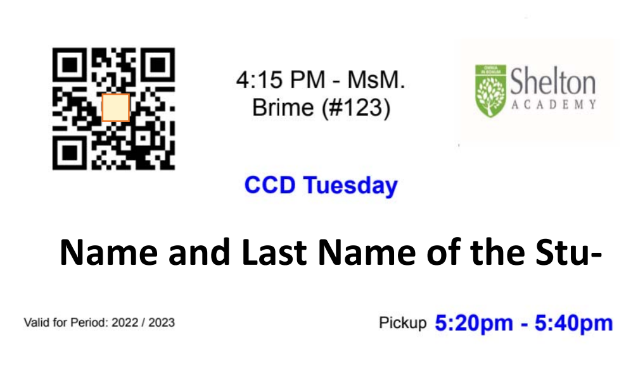
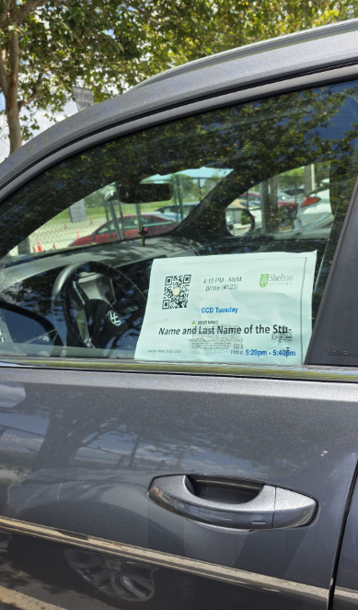
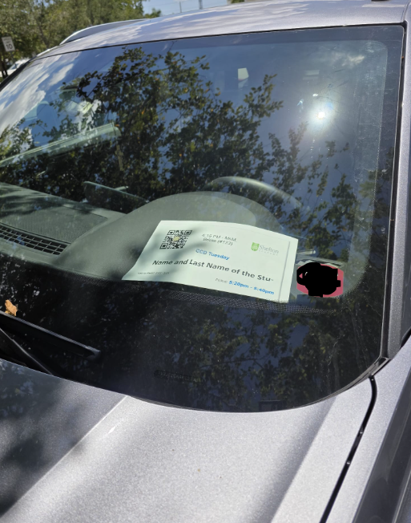
Pick up Barcode for Shelton Academy
For Students @ Shelton Academy
We will provide you with a printed copy on the first day of class
Place it at the * Dash Bord of your Car all the time during the pickup
* or at the Driver Window on raining days all the time

Slide 21
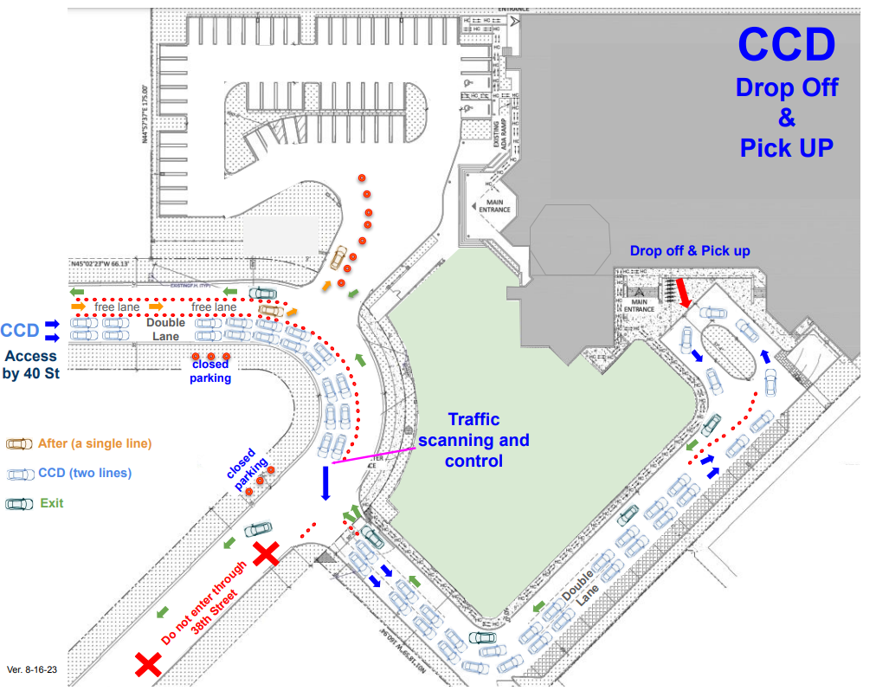
Drop off and Pick up AT SHELTON ACADEMY on Mondays, Tuesdays and Wednesday
Drop off your child at the Designated Drop OFF Area (See map). Do not leave the child on the left side or back of the school. A volunteer or a staff member will open the door of your car and help your child go to his/her class.
For pick up. Do NOT get out of your car to pick up your child. All children must be picked up in a VEHICLE. Your children will NOT be dismissed at the Welcome Center.
Please DO NOT PARK in the middle of the street…. Please HELP US to keep the traffic flowing.
You MUST display the DECAL with the Pre-printed barcode on the RIGHT SIDE of your dashboard.
Do NOT use your cellphone while dropping off or picking up your kid(s).
The speed limit is 5 mph.
Please be kind and keep calm during the drop off and pick up time.
Por favor sea amable y mantenga la paciencia durante la entrada y salida.

Slide 22
Drop off and Pick up AT SHELTON ACADEMY on Mondays, Tuesdays and Wednesday

Slide 23
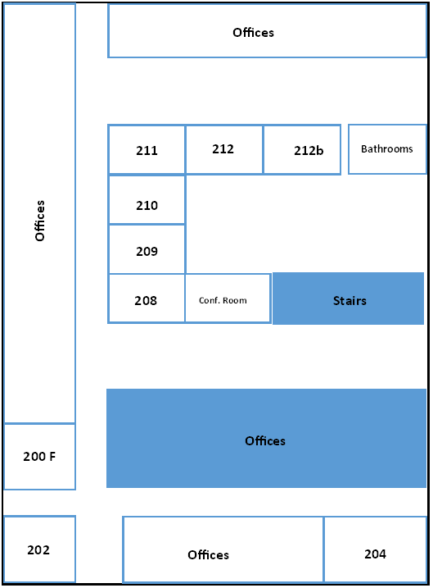
Classrooms @ Shelton

Slide 24

Virtus Training for Students
Please visit this website
Class Given for Parents Given during the Month of November
Class Given by the Catechist Given during the Month of November
www.guadalupedoral.info/forparents/protecting-gods-children/
www.guadalupedoral.info/teaching-touching-safety/

Slide 25

Our Lady of Guadalupe is dedicated to teach the Catholic Faith to the children of our parish. Additionally the Religious Education Department is charged with presenting the “Teaching Touching Safety” program to our students. This program is part of the Archdiocese of Miami’s ongoing effort to help create and maintain safe environments for children. The following is a summary of this year program. Lesson 7: Principle: Educating children about Internet Safety. Specifically: 1) Some Do’s and Don’ts of interacting with people on the Internet, and 2) The importance of protecting yourself and your personal information while using the Internet. Catechism: Man is obliged to follow the moral law, which urges him “to do what is good and avoid what is evil” (cf. GS 16). This law makes itself heard in his conscience. #1713 Goal: To assist children and young people in recognizing the risks of providing personal information to anyone on the Internet and to help them realize how hard it is to know who someone really is when the only avenue of communication is the Internet. Objectives: To teach children and young people safety rules for the Internet and to raise their awareness about the ways adults can use the Internet to confuse and “trick” them into believing things that are not true. The goal for this lesson is not to teach everything about Internet safety but to concentrate on two specific areas: 1) keeping personal information private, and 2) realizing that there is no way to really know who is talking with you on the Internet. The specific learning goals are: Children and young people can learn when to give personal information to an adult and when to keep it private. Children and young people should never give private information to someone they don’t know or can’t see, such as people who might contact them through the Internet.
Virtus Classes. Please read the following and the booklet that is in the bag
https://guadalupedoral.info/teaching-touching-safety/

Slide 26
Lección 7:
Principio: Educar a los niños sobre la Seguridad en Internet. Específicamente: 1) Qué cosas se deben hacer y qué cosas no se deben hacer al interactuar con personas por Internet, y 2) La importancia de protegerse a sí mismo y de proteger tu información personal mientras usas Internet.
Catecismo: El hombre tiene la obligación de cumplir con las leyes morales y ello lo obliga a “hacer el bien y evitar el mal" (cf. GS 16). Esta ley se hace oír en la propia conciencia. #1713
Meta: Ayudar a los niños y a los jóvenes a reconocer los riesgos de proporcionar información personal a personas por Internet y ayudarlos a admitir lo difícil que es saber quién es realmente una persona cuando la única vía de comunicación es la Internet.
Objetivos: Enseñar a los niños y jóvenes las normas de seguridad en Internet y concientizarlos sobre las formas en que los adultos pueden usar Internet para confundirlos, "engañarlos" y hacerles creer cosas que no son ciertas. El objetivo de esta lección no es enseñar todo sobre la seguridad en Internet, sino concentrarse en dos áreas específicas: 1) preservar la información personal, y 2) darse cuenta que no existe forma de saber verdaderamente quién está hablando contigo por Internet. Los objetivos específicos de aprendizaje son los siguientes:  Los niños y jóvenes deben aprender cuándo deben proporcionar información personal a un adulto y cuándo deben preservar su privacidad.
Los niños y jóvenes no deben proporcionar información privada a personas que no conocen o no pueden ver, tal como personas que podrían contactarlos a través de Internet.

Slide 27
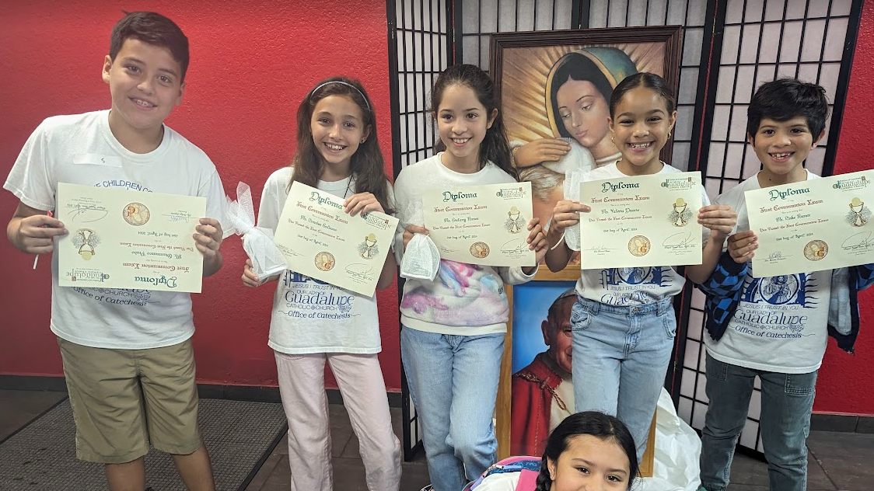
FIRST COMMUNION

Slide 28

Special Activities

Slide 29

Doral Academy: Sunday October 26 8:30 AM & 10:15 AM @ Doral Academy Shelton Academy Monday February 9th Tuesday February 10th & Wednesday February 11th @ Shelton, Regular Class Time

Slide 30

Doral Academy:
Sunday February 8, 2026 8:30 AM & 10:15 AM @ Doral Academy
Shelton Academy (we will do it @ Our Parish Temple)
Monday February 9th @ 5:30 PM Tuesday February 10th @ 5:30 PM Wednesday February 11th @ 5:30 PM

Slide 31
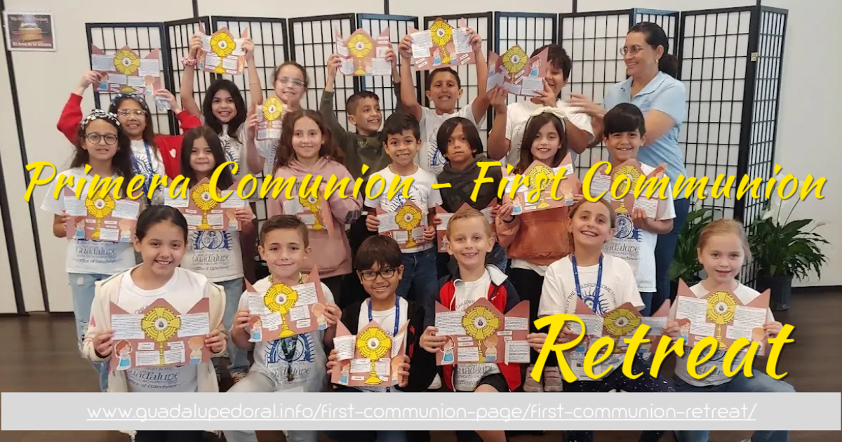
February 28th @ TBA

Slide 32
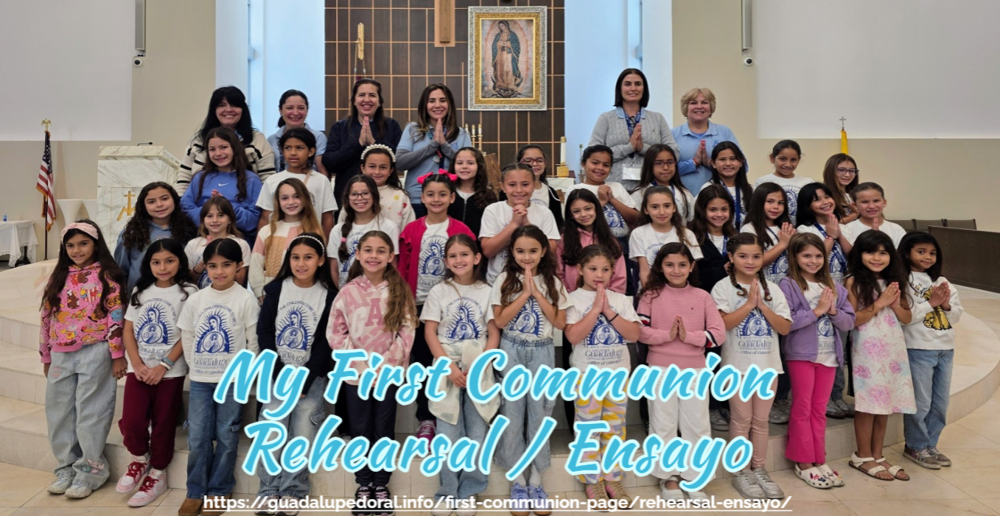
April 11th & 18th 2026

Slide 33
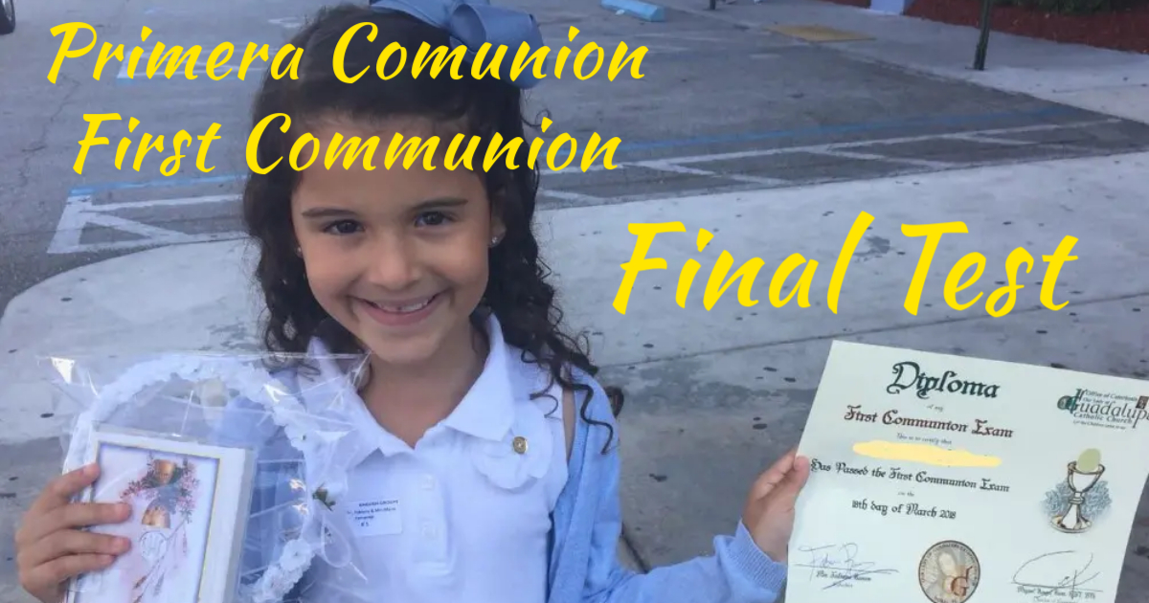
April Sunday 26th
(for CCD Doral Academy High School Students)
April Monday April 27th
April Wednesday 29th
(for CCD Shelton Academy Students)
www.guadalupedoral.info/first-communion-page/first-communion-exam/

Slide 34
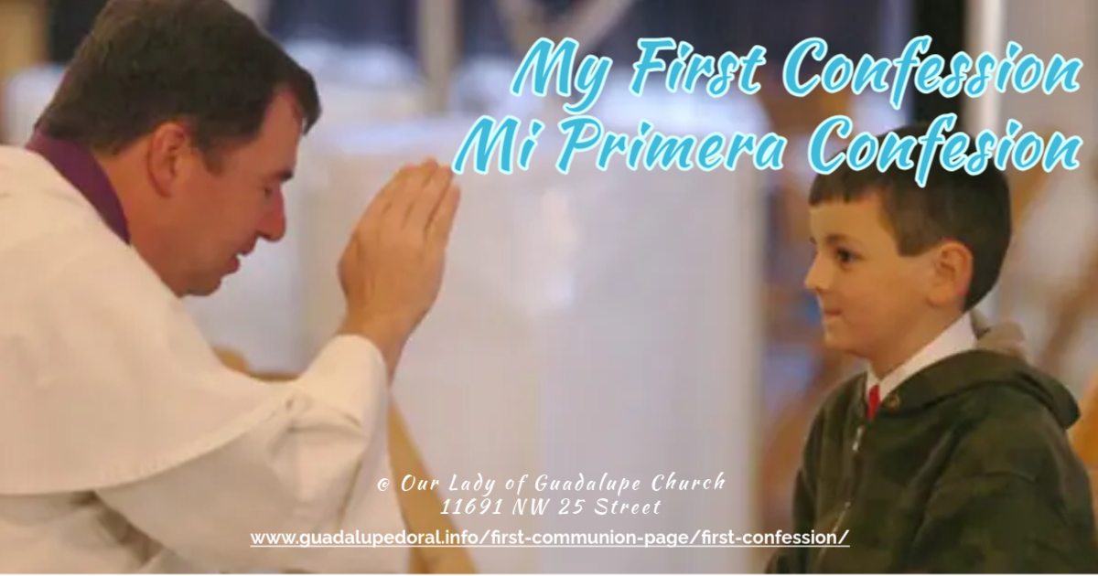
March 14, 2026
^{Schedule TBA}

Slide 35

End of Year Retreat for Parents & Students
Doral Academy:
Sunday May 3rd, 2026
Shelton Academy:
Monday May 4th Tuesday May 5th Wednesday May 6th, 2026

Slide 36
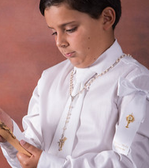
For Boys / Para Niños:
A) You will provide (Cosas que Uds. proveerán)
White long sleeve shirt / Camisa blanca de mangas largas
Blue or Black Pants / Pantalón azul o negro
-NO TIE- / NO CORBATA
B) We will provide (Cosas que nosotros proveeremos)
White Tie / Corbata Blanca
Arm Bow / Lazo de brazo
Dress Code for the First Communion Masses

Slide 37
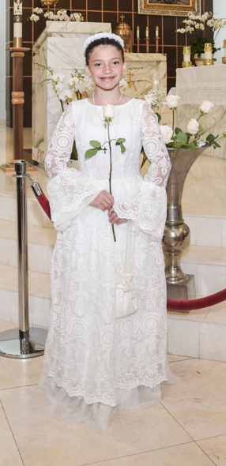
Dress Code - Código de Vestimenta
FOR GIRLS
A) You will provide (Uds. proveerán)
· First Communion Dress / Vestido de primera Comunión
· White dress shoes / Zapatitos blancos de vestir
· No veil / Sin velo
· Ponytail / Cabello recogido
B) We will provide (Nosotros proveeremos)
. Communion Crown / Corona de Primera Comunión
. A Holy Rosary

Slide 38
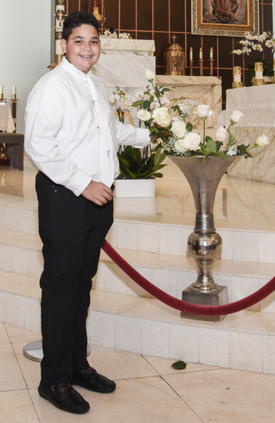
Dress Code - Código de Vestimenta
FOR BOYS
A) You will provide (Uds. proveerán)
· White long sleeve shirt / Camisa blanca de mangas largas
· Blue or Black Pants and dress shoes / Pantalón azul o negro y zapatos de vestir (no tennis – no sneakers)
· No tie – No Corbata
B) We will provide (Nosotros proveeremos)
· White Tie / Corbata Blanca
· Arm Bow / Lazo de brazo
· A Holy Rosary

Slide 39
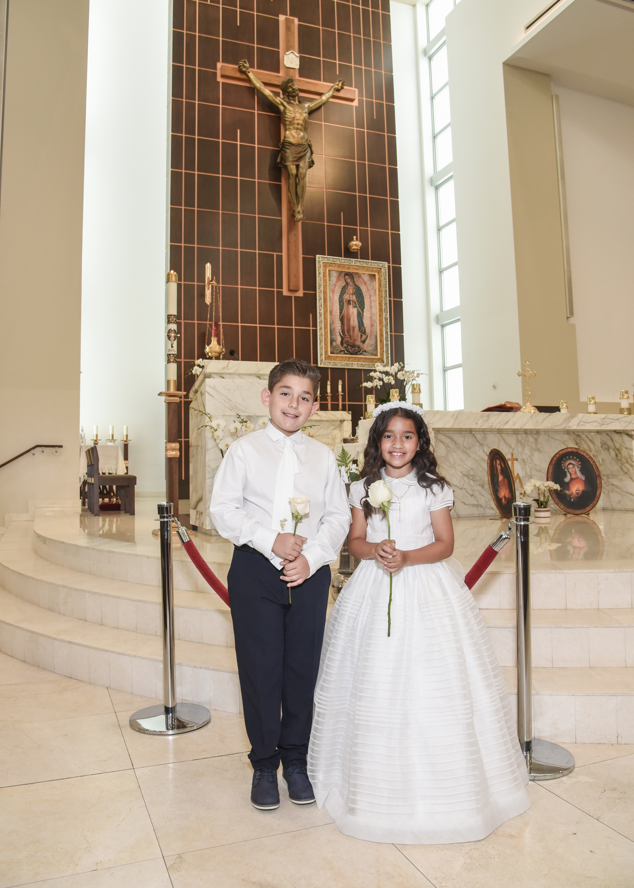
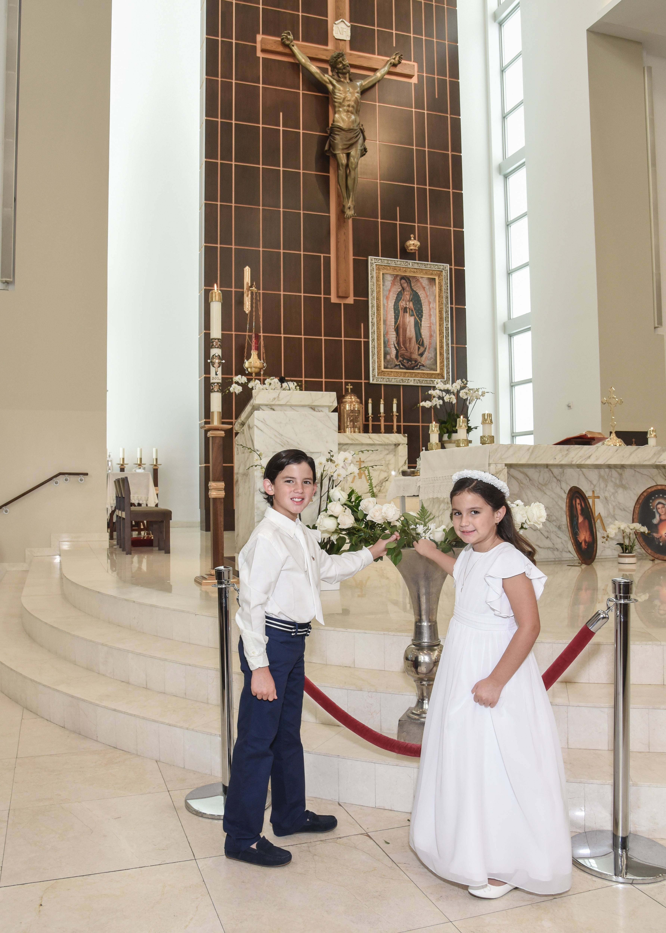
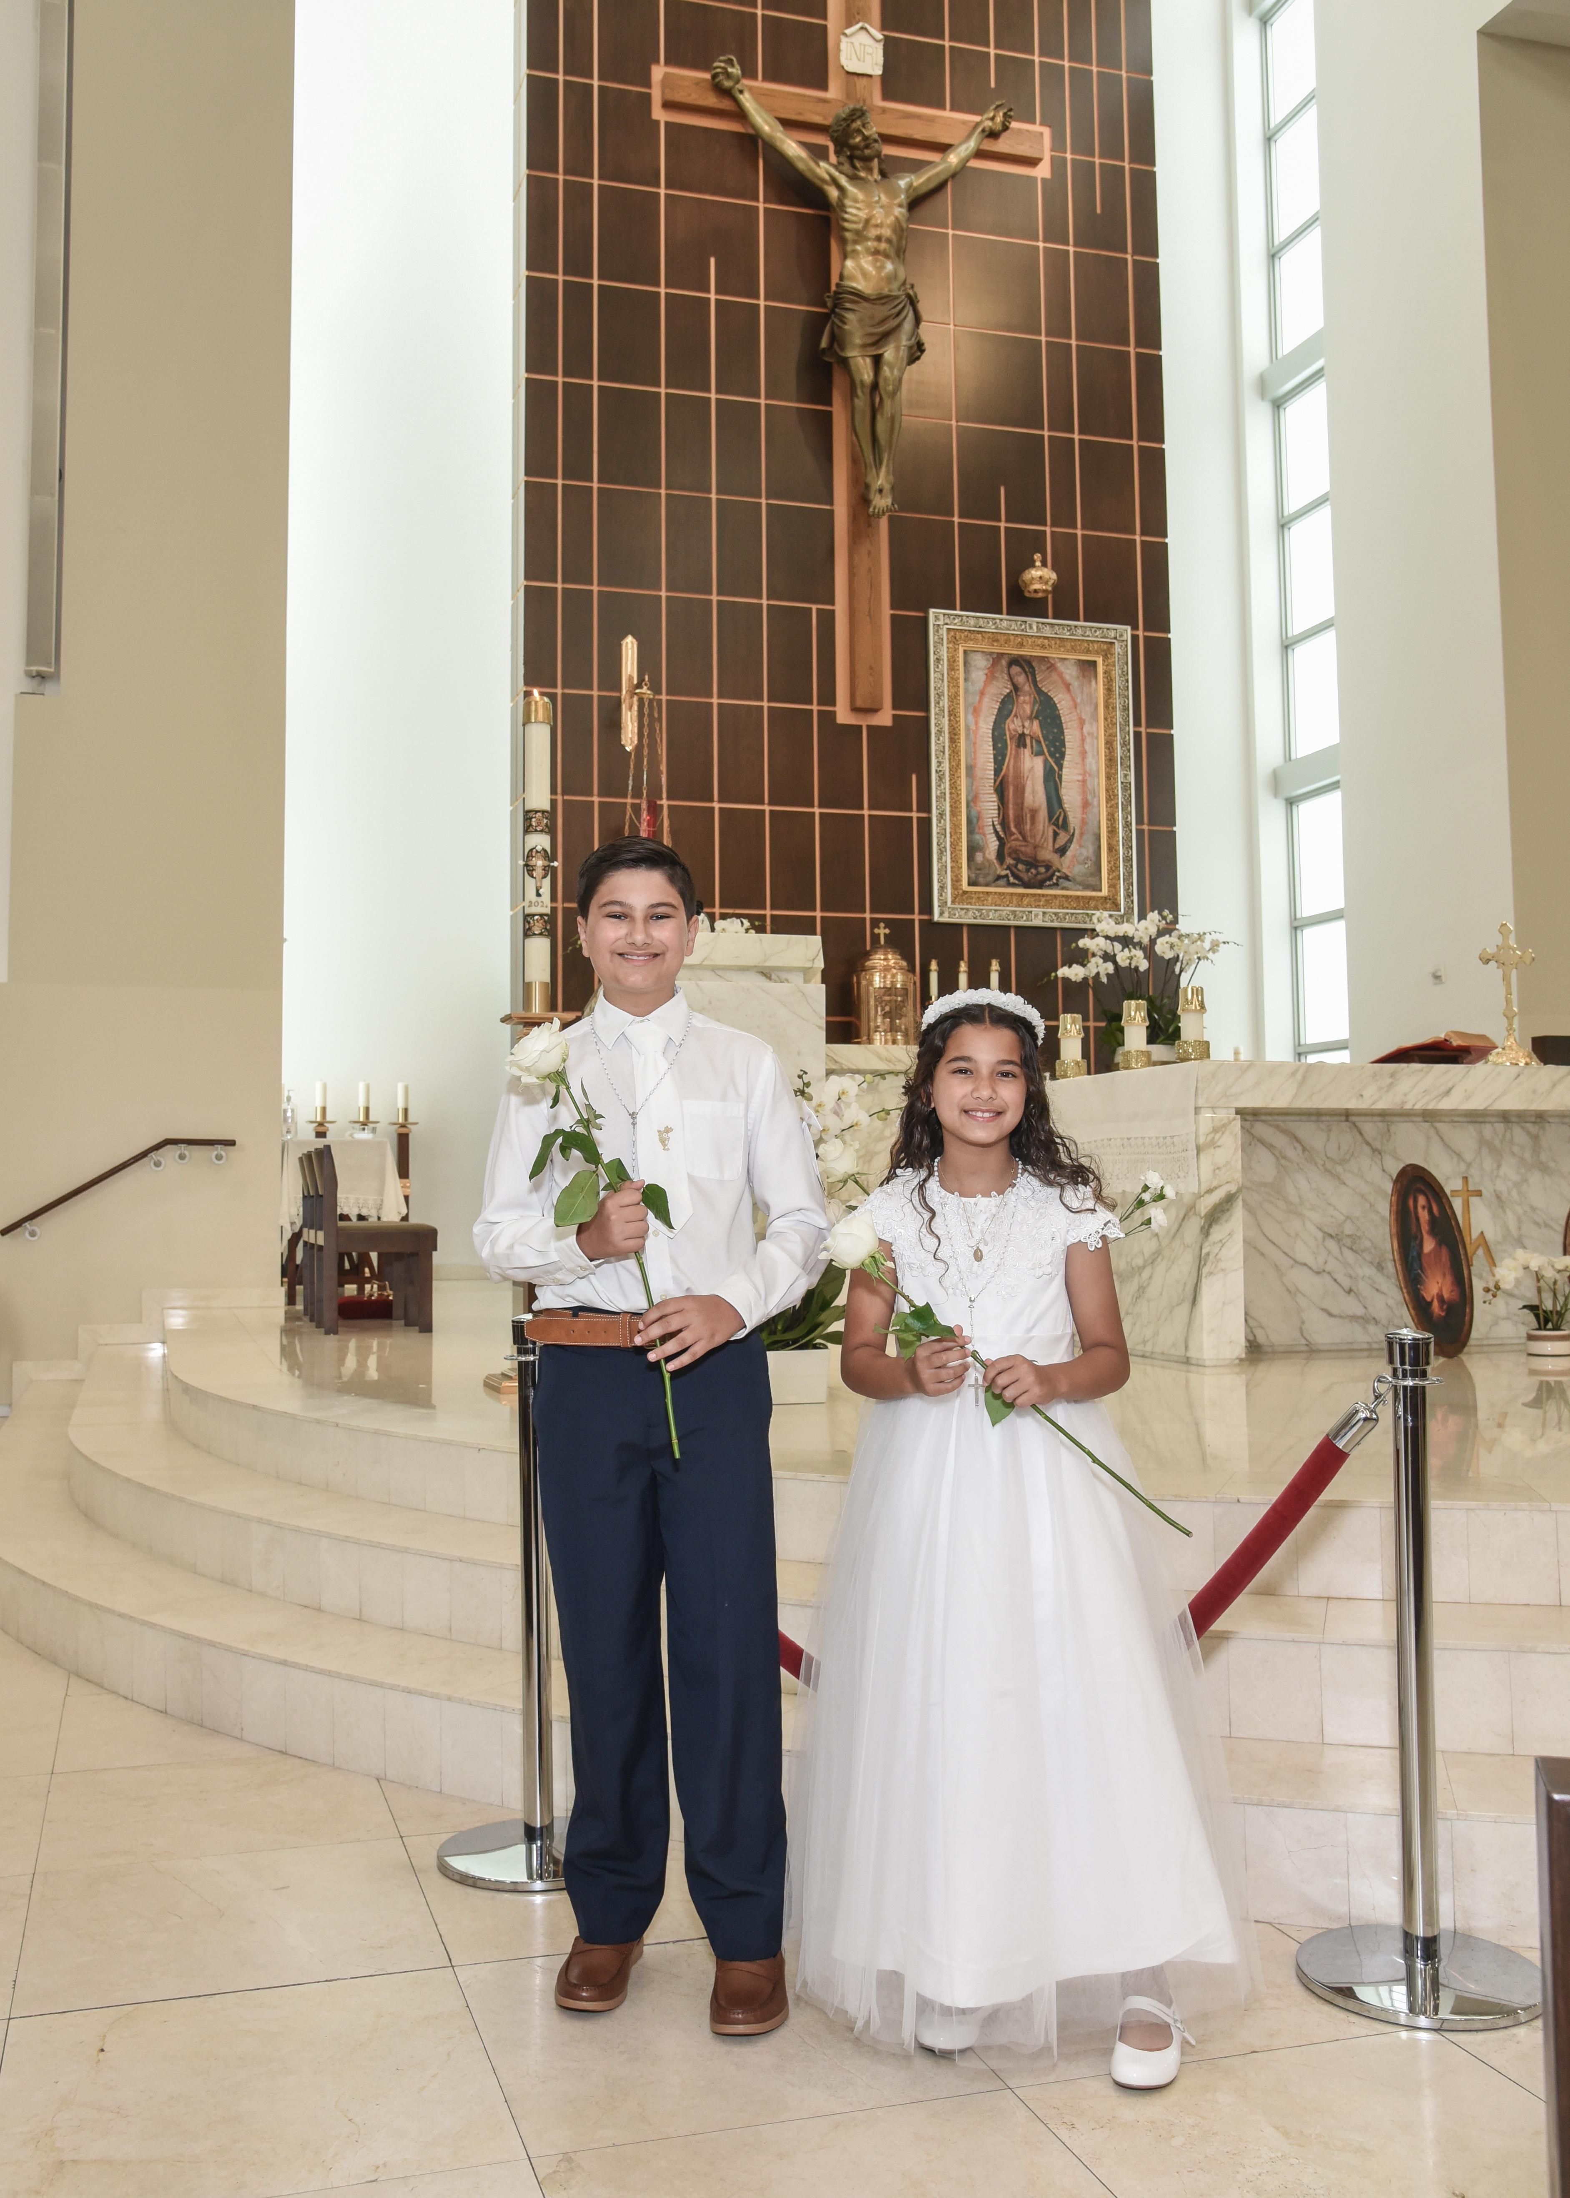
Dress Code - Código de Vestimenta

Slide 40
Dress Code - Código de Vestimenta
FOR PARENTS AND GUESTS
Women and girls
Should wear dresses or skirts that cover the knee completely when sitting or standing.
Women and girls can wear pants and blouse, if they prefer.
Since it is a First Communion, a white color dress would be more appropriate
Men and boys
Should wear suit coats and tie.
Do not, please were
Lacks, shorts, sleeveless, tight or low-cut clothing or dresses with long cuts or slits are to be avoided.
Jeans or short sport pants.
Tennis
Formal Church Attire

Slide 41
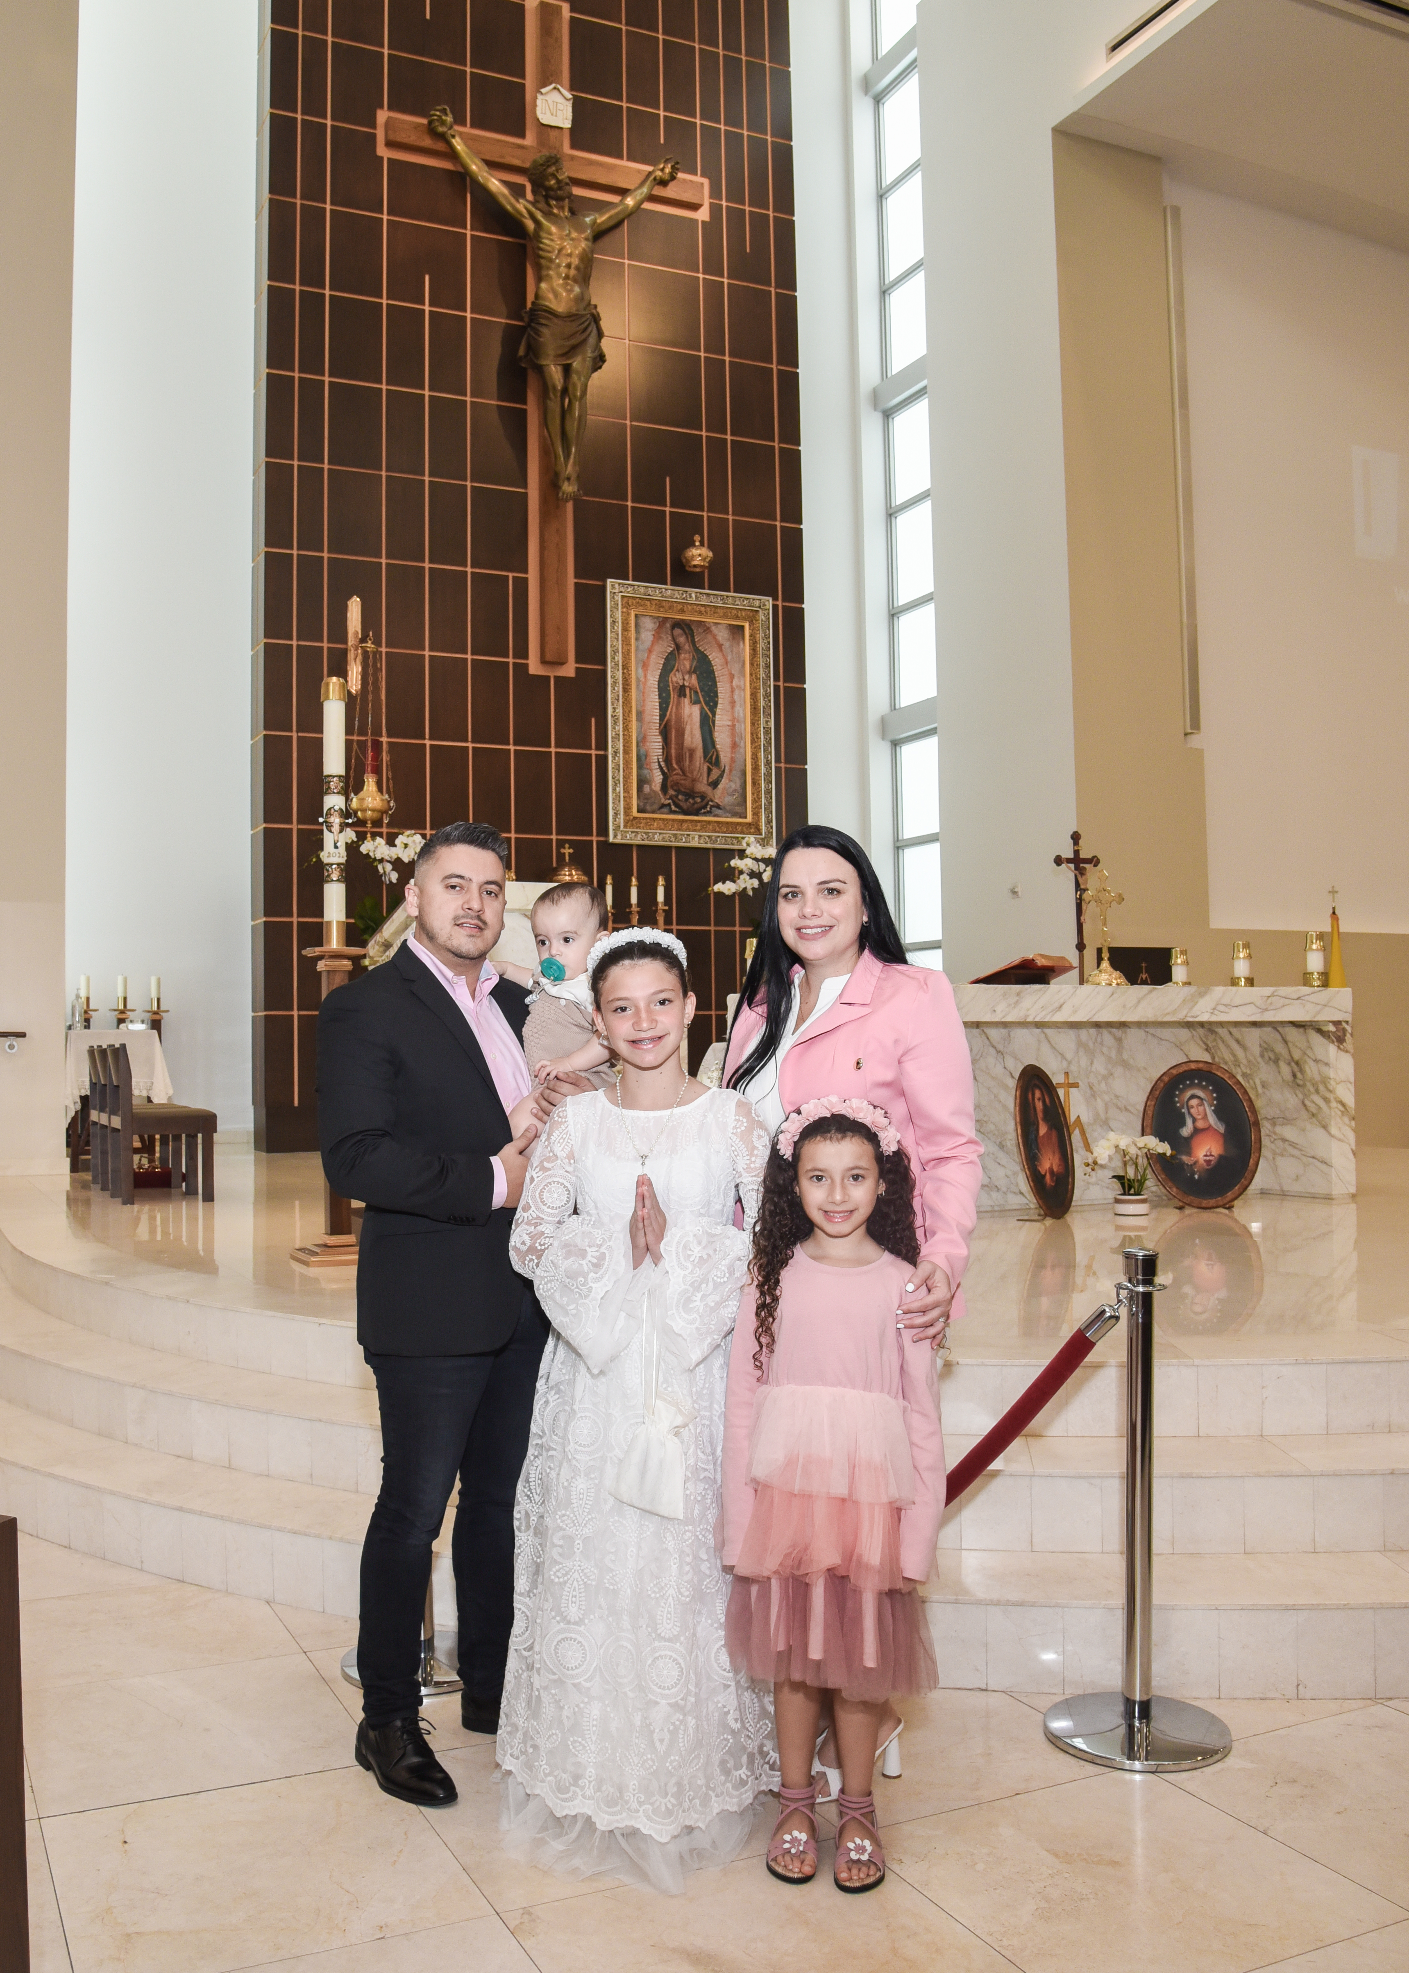
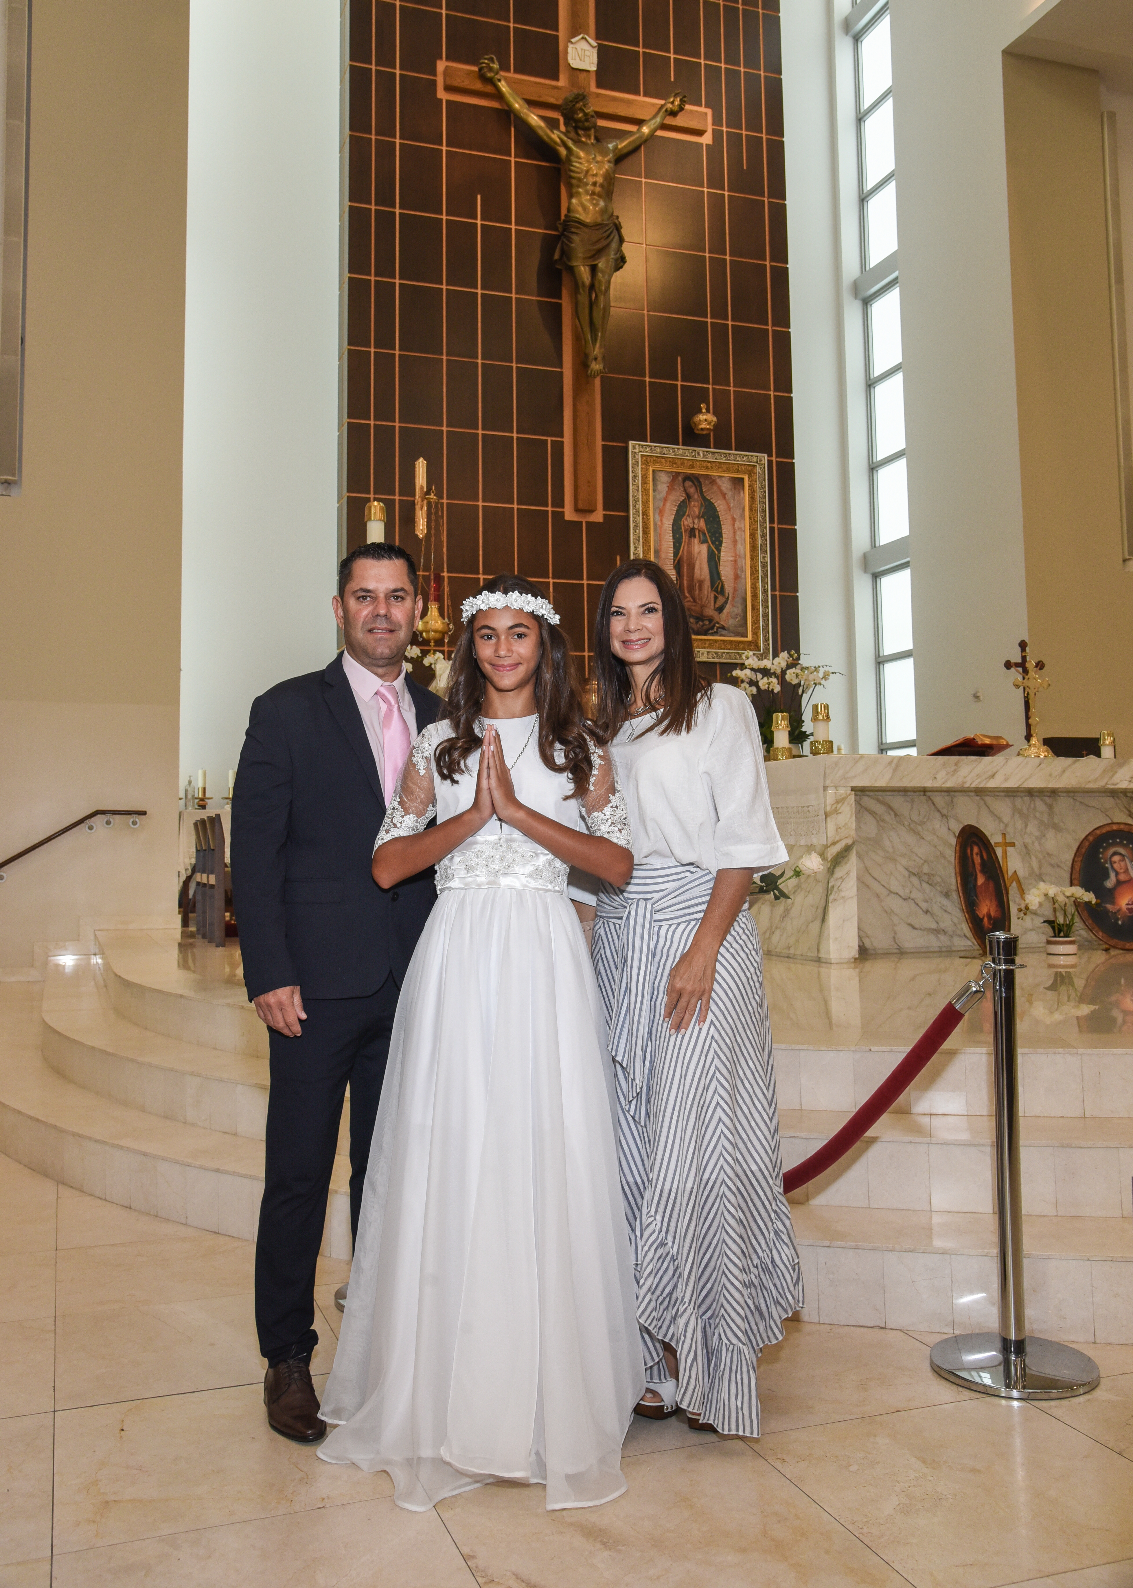
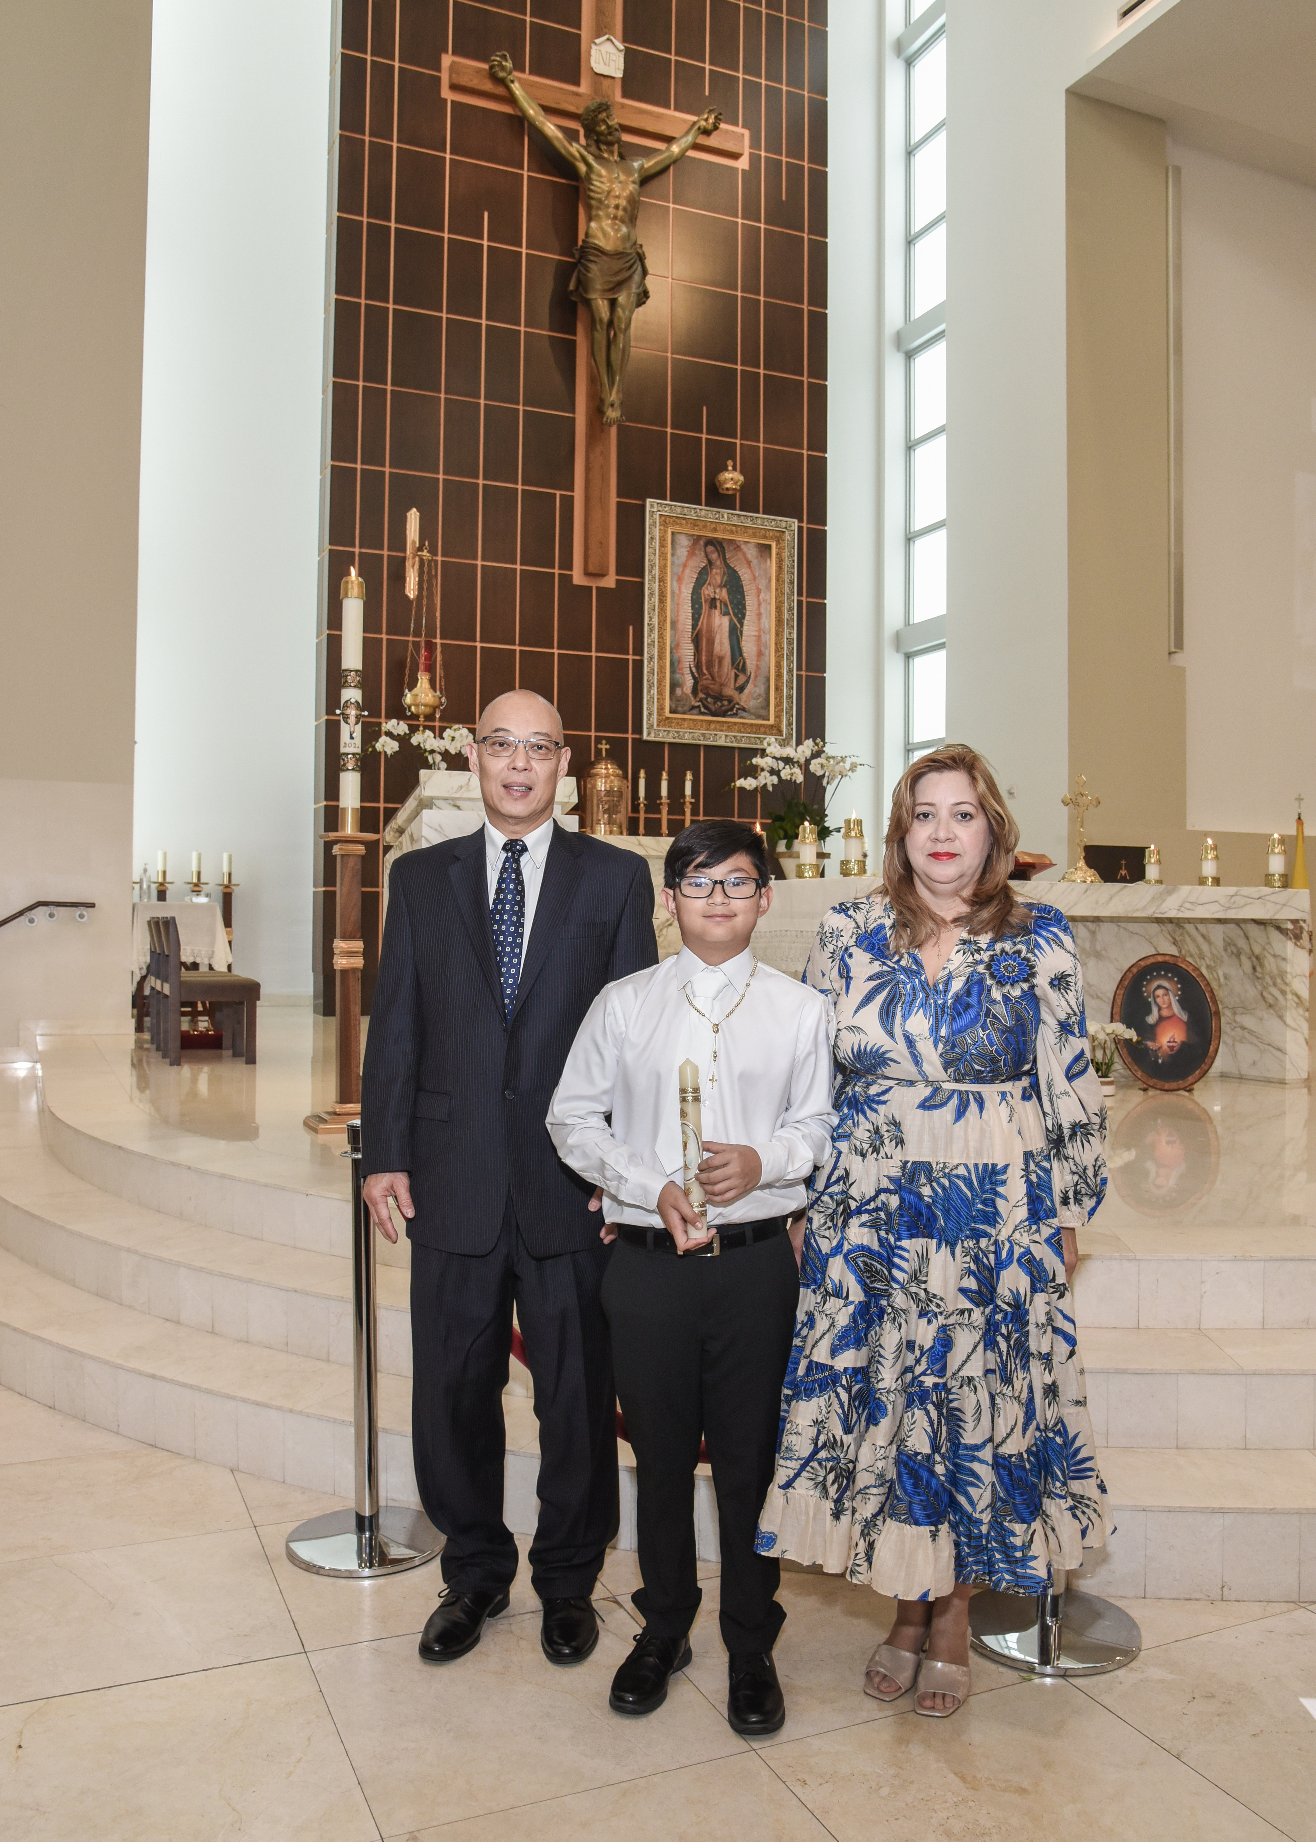
Dress Code - Código de Vestimenta

Slide 42
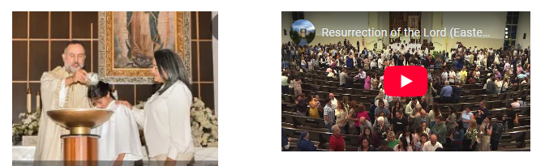
Photo & Video
All the information will be available by November 1st in this link:
www.guadalupedoral.info/forparents/photography/

