Slide 1
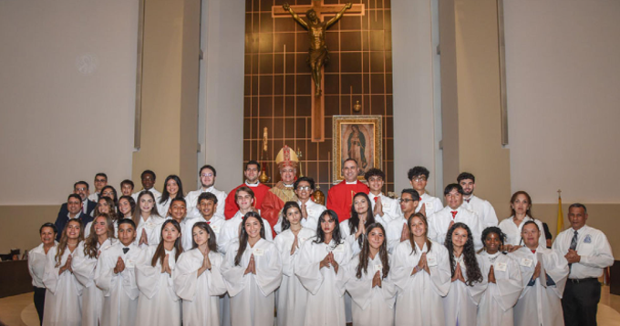


Welcome to the
2025-2026
Catechetical Year
Open House
For CONF 2 & RCIA Mondays
Parish WhatsApp # 786-309-3387 (only message. no calls)
Parish E-Mail: Miguel.ruiz@guadalupedoral.org
Parish Website: www.guadalupedoral.info
Mark your Attendance
https://guadalupedoral.info/open-house/

Slide 2

Special Points
To better understand the Program

Slide 3
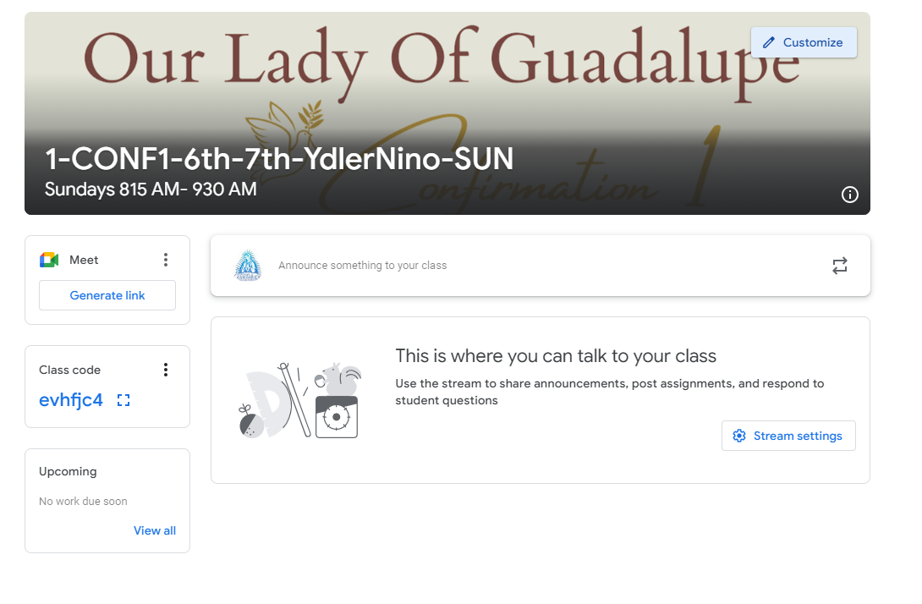
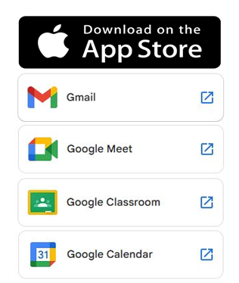
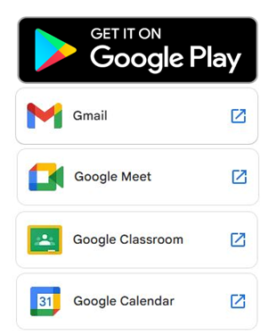
Google Classroom
We will use the Google Classroom as a method of communication. Please log to your Google Classroom account every Friday or Saturday to see any news
Usaremos Google Classroom como metodo de comunicacion. Por favor visiten su cuenta de Google Classroom todos los Viernes o Sabados para ver si hay alguna noticia
GOOGLE CLASSROOM
Login with your parish email / Haga login con el e-mail de la parroquia
a. Username: name.lastname@guadalupedoral.org
b. Password: ****** (the one you selected – el que uds. seleccionaron)
The email account and the google classroom account have the same password / El Email de la parroquia y el google classroom tiene el mismo password
https://classroom.google.com/u/0/h

Slide 4

Parent’s Handbook
Por favor leerlo
Please read it
http://guadalupedoral.info/forparents/parent-handbook/

Slide 5
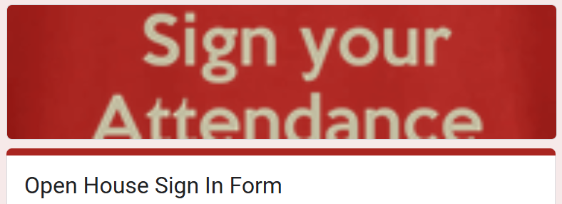
I have watched this Open House Video

Slide 6

Asistencia a Misa
Obligatoria porque Jesús lo manda en el 3er Mandamiento
Mass Attendance: Mandatory because Jesus says so in the 3rd Commandment.
Keep holy the Lord’s day is the 3rd Commandment
We must attend Mass every Sunday.
We must attend Mass in Person
In our Parish of Guadalupe
Or in any Catholic Parish
MASS ATTENDANCE LOG
Watch this Video/Vean este Video
https://guadalupedoral.info/mass-attendance-log/
You will get these messages every week through your Google Classroom
Recibirán estos mensajes semanalmente en Google Classroom

Slide 7
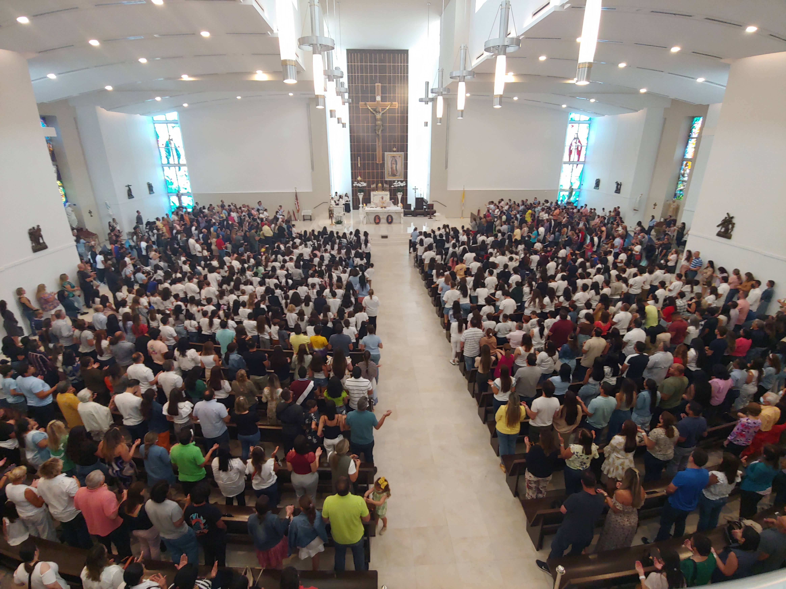
First Mass and Blessing for all our Students
Saturday 09/14 | 5:30 pm | English
 | 7:00 pm | Español
Sunday 09/15 | 8:30 am | English
 | 10:00 am | Español
 | 11:45 am | English
 | 1:30 pm | Español
 | 7:00 pm | Español

Slide 8
First day of Classes for kids and parents
CCD/RCIA First day of Classes & Locations in Our Lady of Guadalupe Church The First Day at least one Adult must stay with the Students (1st grade to 12th grade)
SUNDAY for all Students (Kids, Teens & Adults) enrolled in Classes at Doral Academy High School (11100 NW 27th St, Doral, FL 33172) * Communion Students (FC1 & FC2): September 14th * Confirmation Students (CONF1 & CONF2): September 14th * Special Need & Baptism: September 14th * Adults English Candidates: September 14th
MONDAY for all Students enrolled in Classes at Shelton Academy (9455 NW 40th Street Rd, Doral, FL 33178) * Communion Students (FC1) Students: September 15th
MONDAY for all Students (Young Adults & Adults) enrolled in RCIA Classes at Parish Hall (11691 NW 25th Street, Doral, 33172) * Young Adults Candidates: September 15th * Adults Candidates: September 15th
TUESDAY for all Students enrolled in Classes at Shelton Academy (9455 NW 40th Street Rd, Doral, FL 33178) * Communion Students (FC1): September 16th * Confirmation Students (CONF1): September 16th
5. WEDNESDAY for all Students enrolled in Classes at Shelton Academy (9455 NW 40th Street Rd, Doral, FL 33178) * Communion Students (FC2): September 17th * Confirmation Students (CONF2): September 17th

Slide 9
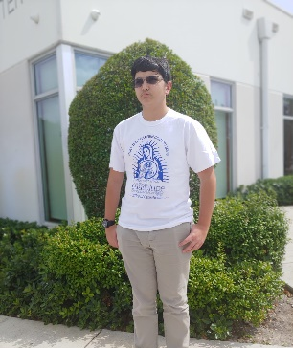
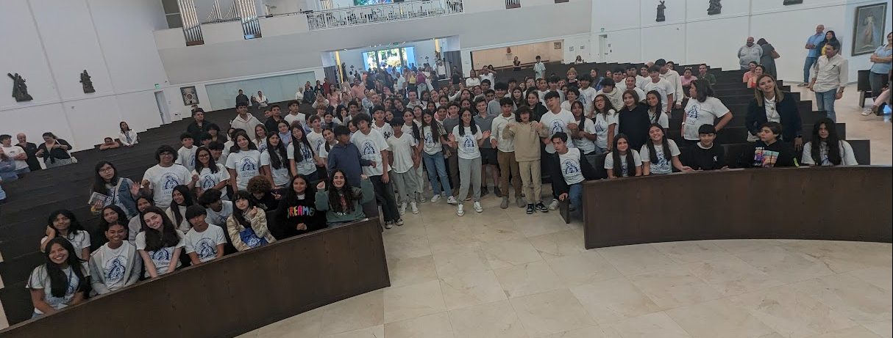
Uniform
For Middle & High Schoolers
Blue, Kaki or Jeans pants or skirts
Our Lady of Guadalupe T-Shirt
ID Tag

Slide 10
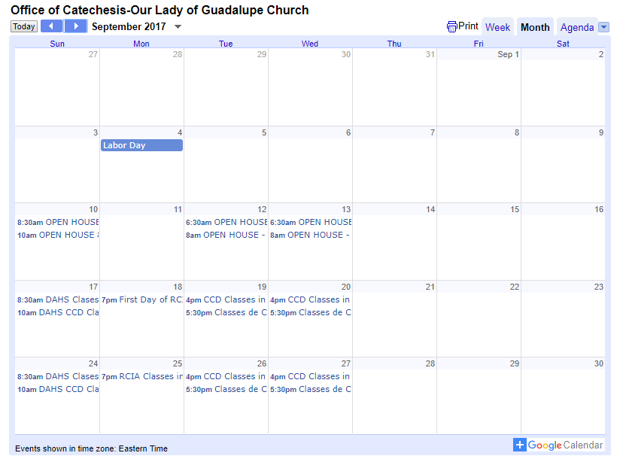
Calendario / Calendar
From your cellphone subscribe to our calendar by clicking over the +Google Calendar Icon that is at the bottom right corner of the online calendar and follow the instructions.
You might need to download the Google Calendar application.
Desde su celular suscríbase a nuestro calendario haciendo click sobre el +Google Calendar que está en la esquina inferior derecha del calendario electrónico y siga las instrucciones.
Tal vez tenga que bajar la aplicación Google Calendar.
The Official Calendar is posted in our website
http://guadalupedoral.info/calendar/ and download the Calendar
2025-2026
CCD Calendar

Slide 11
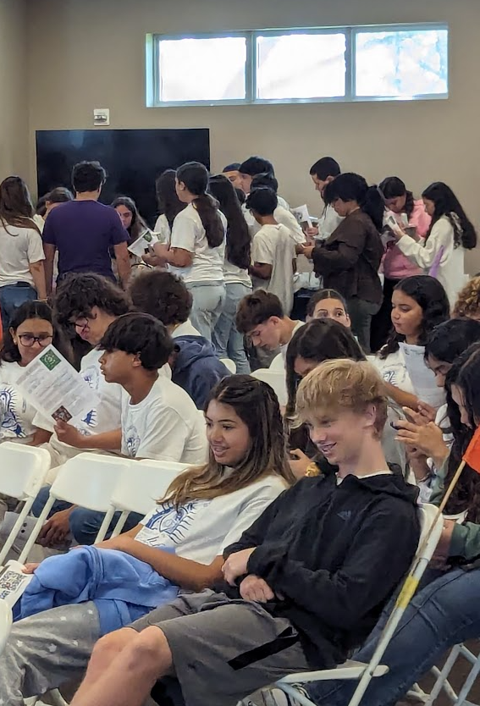


Class Attendance
1) Deben asistir a todas las clases
We must take our children to class.
2) MAXIMUM OF ABSENCES: Se puede faltar hasta 4 veces
They may be absent up to 4 times in a year
3) EXCUSE ABSENCE: Se debe enviar por e-mail el justificativo de la inasistencia. Se debe notificar al catequista y a la Oficina de la Parroquia.You must send via e-mail a Justification Note to your catechist and to the Office of Catechesis (ccd@guadalupedoral.org) & (your catechist e-mail) Sports practice, dance class, etc. are not considered Excused Absences. Las prácticas deportivas, las clases de baile, etc., no se consideran faltas justificables
4) NO LATE ARRIVAL: LOS NINOS DEBEN ESTAR SENTADOS AL MOMENTO DE COMENZAR, LA CLASE, Si llegan tarde no podrán ingresar al salón. STUDENTS MUST BE AT THEIR DESK ON TIME, if they arrive late, they will NOT be able to enter in the classroom
5) NO EARLY RELEASE: Students are not permitted to leave class early except in emergency situations. Sports practice, dance class, etc. are not considered emergencies. No se permite a los estudiantes salir de clase antes de tiempo, excepto en situaciones de emergencia. Las prácticas deportivas, las clases de baile, etc., no se consideran emergencias
Check your catechist Email in this link www.guadalupedoral.info/forcatechists/our-team/

Slide 12


Material/ School Supplies
For middle and high school students & RCIA
A composition notebook
A sharpened pencil, a pen, and an eraser
One (1) reams of paper as a DONATION (if you can)

Slide 13
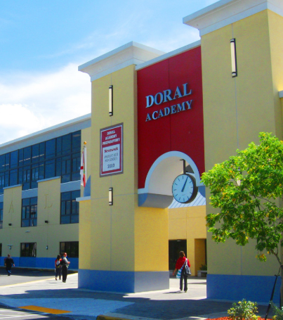
Special Points
To those attending Classes at Doral Academy HS
11100 NW 27 Street, Doral, Fl 33178
Sundays / Domingos 8:15-9:30 AM en Espanol 10:00-11:15 AM in English

Slide 14

Classes of Formation for Parents
This year we will provide Classes of Catholic Formation for Parents.
Classes will be given at the same time than the kids’ classes. Este año brindaremos Clases de Formación Católica para Padres.
Las clases se darán al mismo tiempo que las clases de los niños.
We will notify you as soon as we have the schedule

Slide 15

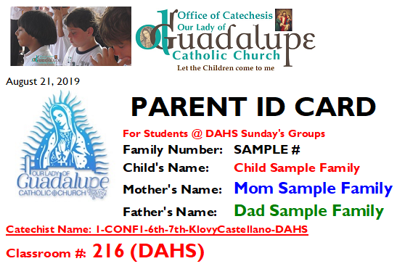
Pick up Parents’ ID for DAHS
For Students @ DAHS We will send it via email, so you show it to your catechist at the moment of picking up your child from the classroom. Please keep it in your Phone

Slide 16
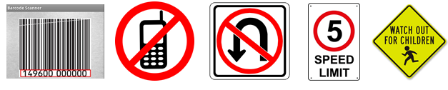
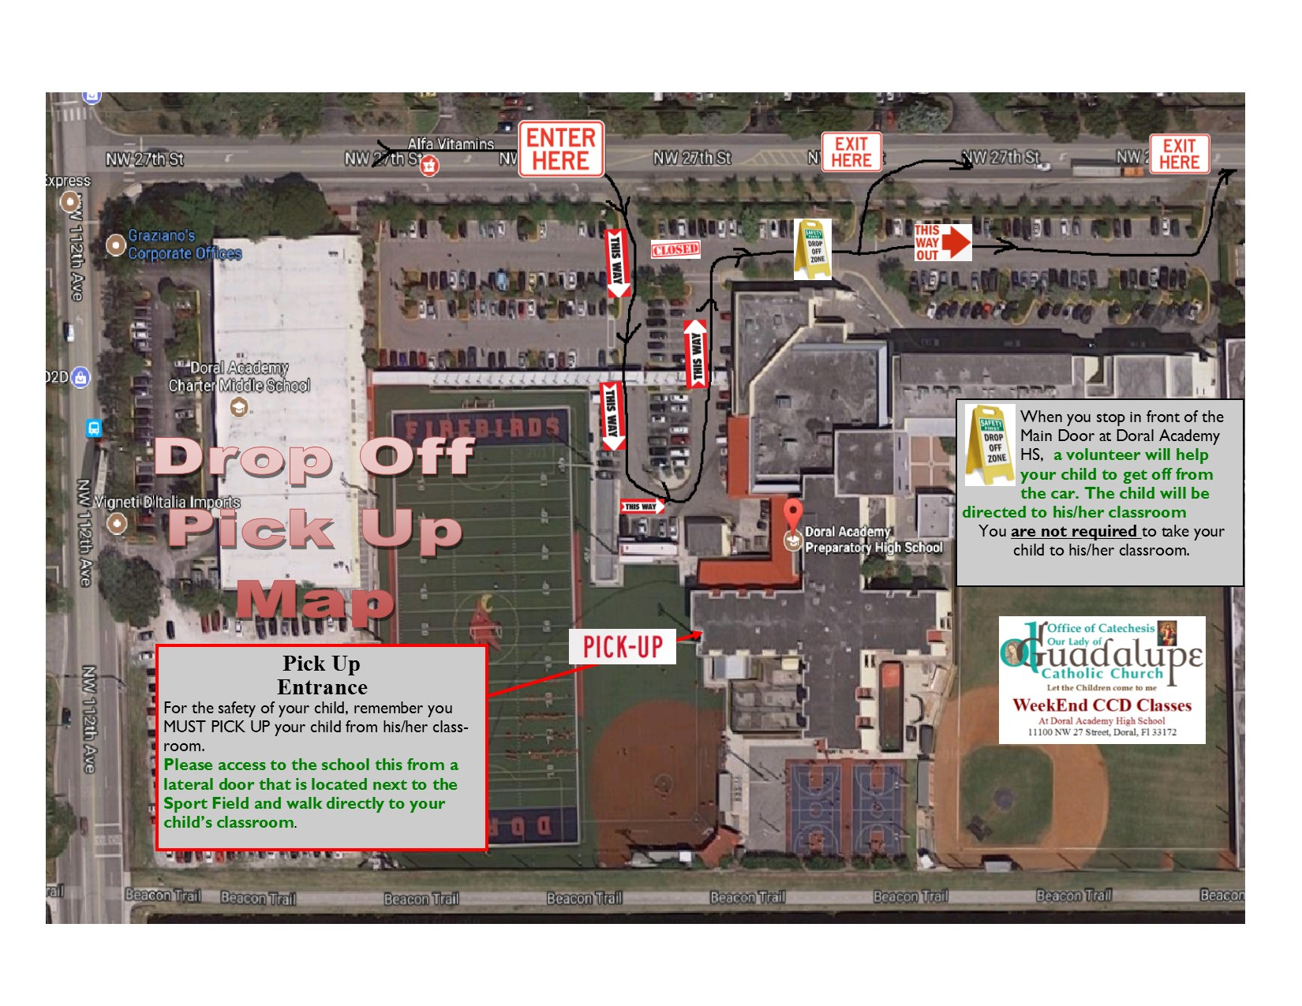
Drop off and Pick up AT DORAL ACADEMY HIGH SCHOOL on Sundays
Please do not drop students in the Street (at 27th). It is prohibited for safety reasons. / Por favor no deje a sus hijos en la Calle (27th). Está prohibido por seguridad.
You must take your child to the classroom. / Ud. Debe dejar a su hijo en el salon.
You MUST pick up your child from the Classroom / Ud. DEBE recoger a su hijo del salón
Only 6th graders and older with the Written Parents Consent may leave the classroom by themselves, but cannot leave the school, you need to pick them up. / Solo jóvenes en 6to grado para arriba pueden salir del salón solos, siempre que tengamos su Permiso por escrito, pero ellos no pueden irse de la escuela solos, uds. deben recogerlos. (YOU WILL RECEIVE IT IN YOUR GOOGLE CLASSROOM)
Please be kind and keep calm during the drop off and pick up time. / Por favor sea amable y mantenga la paciencia durante la entrada y salida.

Slide 17
Drop off and Pick up AT DORAL ACADEMY HIGH SCHOOL on Sundays

Slide 18
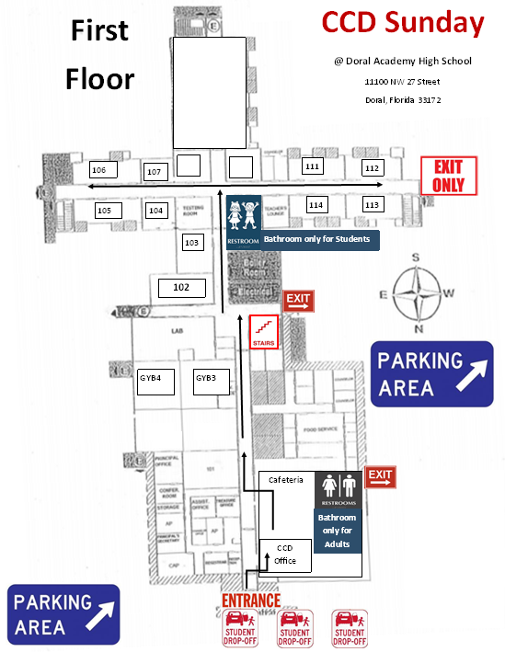
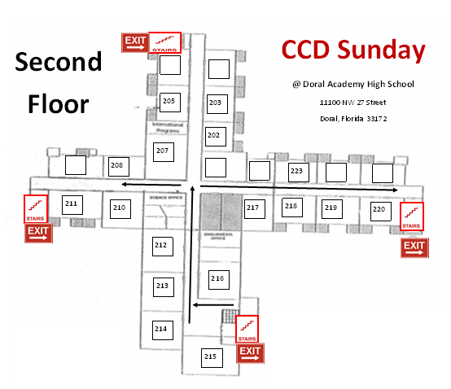
Classrooms @ DAHS

Slide 19
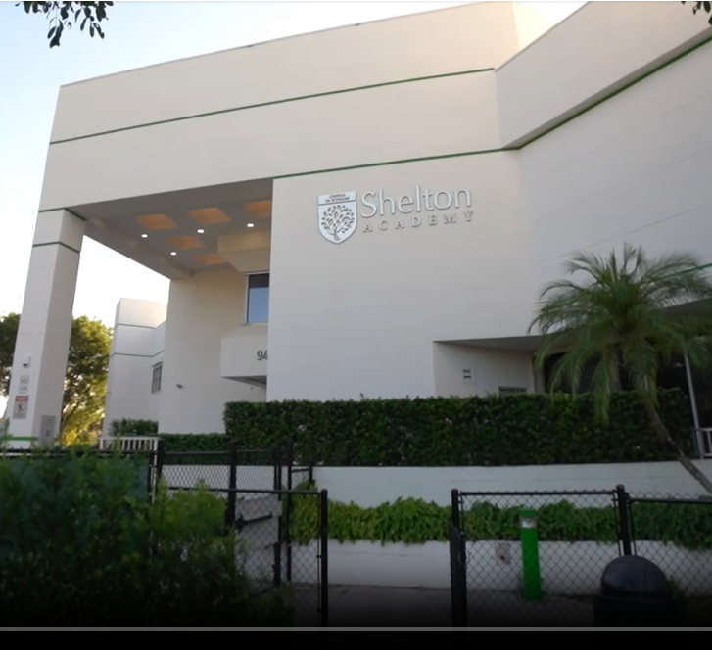
Special Points
To those attending Classes at Shelton Academy
Lunes 5:20-6:30 PM en Espanol
Tuesday/Martes 4:20-5:30 PM in English 5:50-7:00 PM en Espanol
Wednesday/Miercoles 4:20-5:30 PM in English 5:50-7:00 PM en Espanol
9455 NW 40 Street Road, Doral, Fl 33178

Slide 20
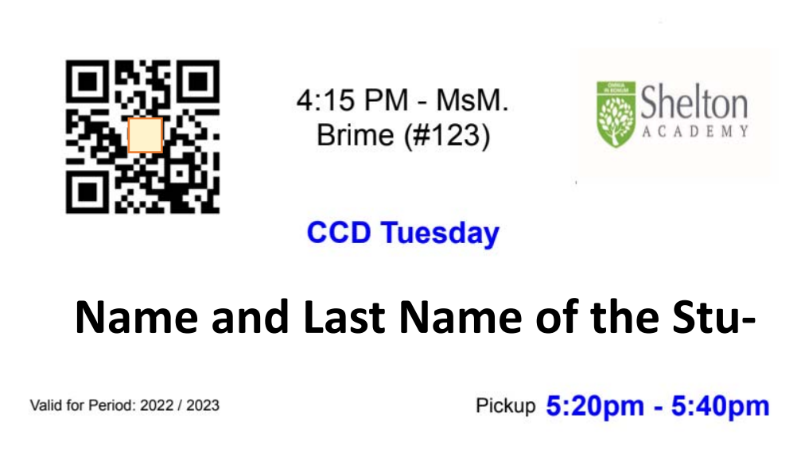
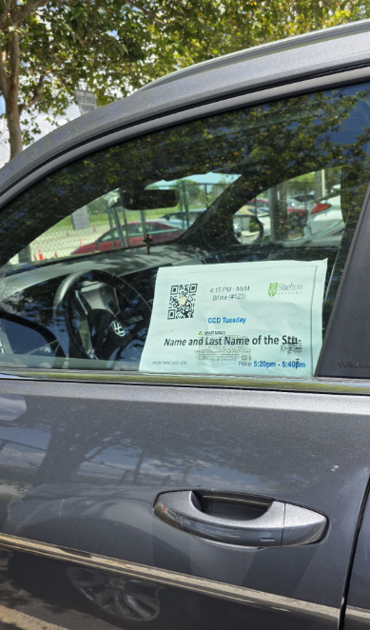
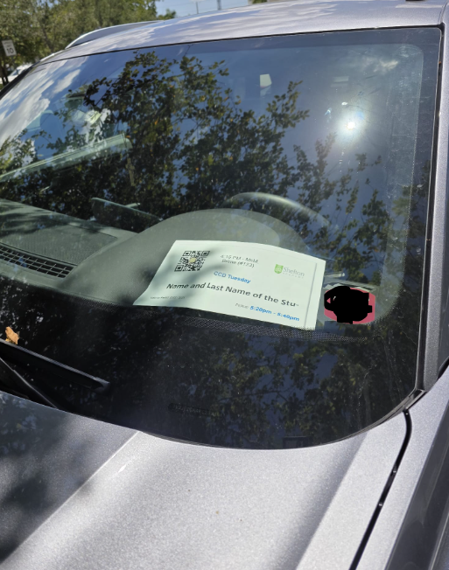
Pick up Barcode for Shelton Academy
For Students @ Shelton Academy
We will provide you with a printed copy on the first day of class
Place it at the * Dash Bord of your Car all the time during the pickup
* or at the Driver Window on raining days all the time

Slide 21
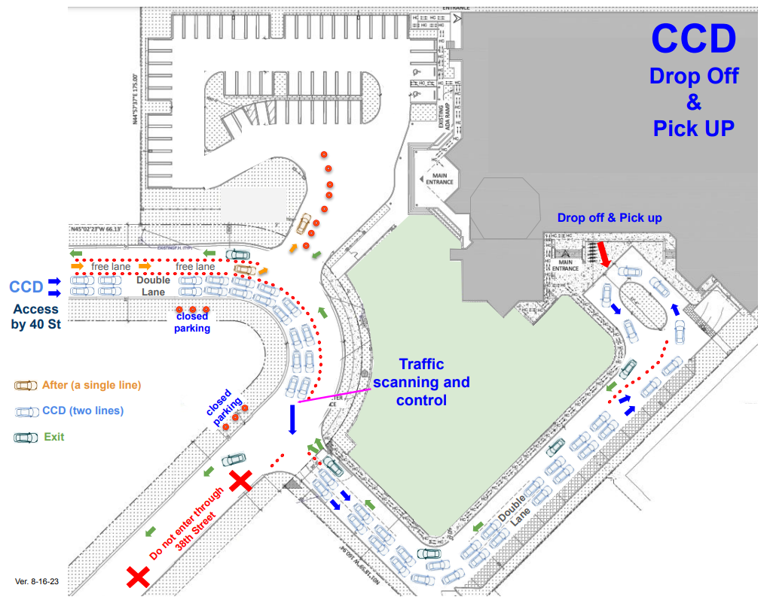
Drop off and Pick up AT SHELTON ACADEMY on Mondays, Tuesdays and Wednesday
Drop off your child at the Designated Drop OFF Area (See map). Do not leave the child on the left side or back of the school. A volunteer or a staff member will open the door of your car and help your child go to his/her class.
For pick up. Do NOT get out of your car to pick up your child. All children must be picked up in a VEHICLE. Your children will NOT be dismissed at the Welcome Center.
Please DO NOT PARK in the middle of the street…. Please HELP US to keep the traffic flowing.
You MUST display the DECAL with the Pre-printed barcode on the RIGHT SIDE of your dashboard.
Do NOT use your cellphone while dropping off or picking up your kid(s).
The speed limit is 5 mph.
Please be kind and keep calm during the drop off and pick up time.
Por favor sea amable y mantenga la paciencia durante la entrada y salida.

Slide 22
Drop off and Pick up AT SHELTON ACADEMY on Mondays, Tuesdays and Wednesday

Slide 23
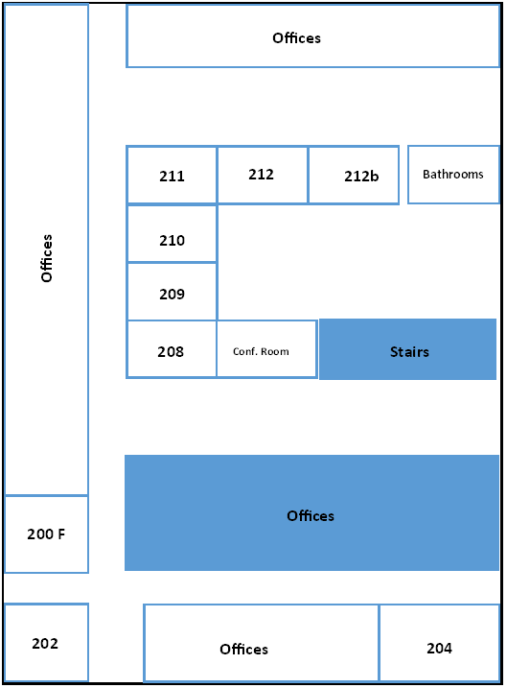
Classrooms @ Shelton

Slide 24

Virtus Training for Students
Please visit this website
Class Given for Parents Given during the Month of November
Class Given by the Catechist Given during the Month of November
www.guadalupedoral.info/forparents/protecting-gods-children/
www.guadalupedoral.info/teaching-touching-safety/

Slide 25

Our Lady of Guadalupe is dedicated to teach the Catholic Faith to the children of our parish. Additionally the Religious Education Department is charged with presenting the “Teaching Touching Safety” program to our students. This program is part of the Archdiocese of Miami’s ongoing effort to help create and maintain safe environments for children. The following is a summary of this year program. Lesson 7: Principle: Educating children about Internet Safety. Specifically: 1) Some Do’s and Don’ts of interacting with people on the Internet, and 2) The importance of protecting yourself and your personal information while using the Internet. Catechism: Man is obliged to follow the moral law, which urges him “to do what is good and avoid what is evil” (cf. GS 16). This law makes itself heard in his conscience. #1713 Goal: To assist children and young people in recognizing the risks of providing personal information to anyone on the Internet and to help them realize how hard it is to know who someone really is when the only avenue of communication is the Internet. Objectives: To teach children and young people safety rules for the Internet and to raise their awareness about the ways adults can use the Internet to confuse and “trick” them into believing things that are not true. The goal for this lesson is not to teach everything about Internet safety but to concentrate on two specific areas: 1) keeping personal information private, and 2) realizing that there is no way to really know who is talking with you on the Internet. The specific learning goals are: Children and young people can learn when to give personal information to an adult and when to keep it private. Children and young people should never give private information to someone they don’t know or can’t see, such as people who might contact them through the Internet.
Virtus Classes. Please read the following and the booklet that is in the bag
https://guadalupedoral.info/teaching-touching-safety/

Slide 26
Lección 7:
Principio: Educar a los niños sobre la Seguridad en Internet. Específicamente: 1) Qué cosas se deben hacer y qué cosas no se deben hacer al interactuar con personas por Internet, y 2) La importancia de protegerse a sí mismo y de proteger tu información personal mientras usas Internet.
Catecismo: El hombre tiene la obligación de cumplir con las leyes morales y ello lo obliga a “hacer el bien y evitar el mal" (cf. GS 16). Esta ley se hace oír en la propia conciencia. #1713
Meta: Ayudar a los niños y a los jóvenes a reconocer los riesgos de proporcionar información personal a personas por Internet y ayudarlos a admitir lo difícil que es saber quién es realmente una persona cuando la única vía de comunicación es la Internet.
Objetivos: Enseñar a los niños y jóvenes las normas de seguridad en Internet y concientizarlos sobre las formas en que los adultos pueden usar Internet para confundirlos, "engañarlos" y hacerles creer cosas que no son ciertas. El objetivo de esta lección no es enseñar todo sobre la seguridad en Internet, sino concentrarse en dos áreas específicas: 1) preservar la información personal, y 2) darse cuenta que no existe forma de saber verdaderamente quién está hablando contigo por Internet. Los objetivos específicos de aprendizaje son los siguientes:  Los niños y jóvenes deben aprender cuándo deben proporcionar información personal a un adulto y cuándo deben preservar su privacidad.
Los niños y jóvenes no deben proporcionar información privada a personas que no conocen o no pueden ver, tal como personas que podrían contactarlos a través de Internet.

Slide 27

Reading
Essays

Slide 28
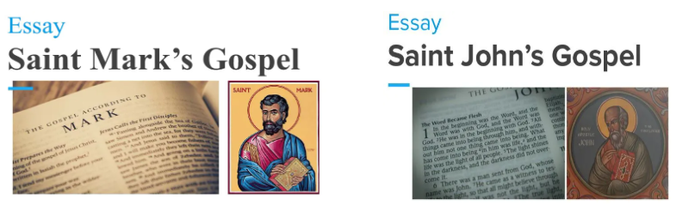
1) Essays for Confirmation Students middle-high school & RCIA
Everything will be submitted, through your Google Classroom
2 documents SUBMITED BY THE STUDENT (Different Deadlines TBA via Google Classroom)
(Sample: https://bit.ly/3DzejVn)

Slide 29
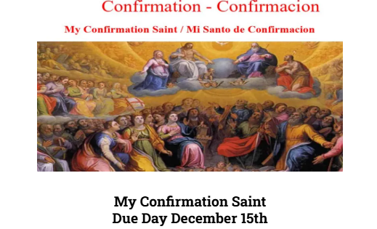
2) The Saint Name Document the Candidates must SUBMIT it BY December 15th
Purpose of this assignment:
When deciding on a Confirmation name, the goal is to choose the name of a saint you admire, can relate to, or aspire to be like. This saint will be bonded to you spiritually and will be your role model in life. They can be the one you turn to for guidance and protection during life’s challenges. Throughout the Bible, there are many examples of people taking on new names, dating back to the Old Testament. God changed the names of many to reflect the special roles they’d play throughout the history of the Church. For example, God changed Abram’s name to Abraham meaning, “father to a host of nations.” This name change signified that God was making a covenant with Abraham that would make him the first of God’s people on earth. Simon’s name was changed to Peter, meaning “rock” and refers to Peter becoming the first pope: “And upon this rock I will build my church” (Matthew 16:17-18)
How to choose a Confirmation Saint?
Boys must choose a Male saint
Girls must choose a Female saint
You may search for your saint name at: www.catholic.org/saints/

Slide 30

3) Sponsor Requirements
Requisitos de los Padrinos

Slide 31
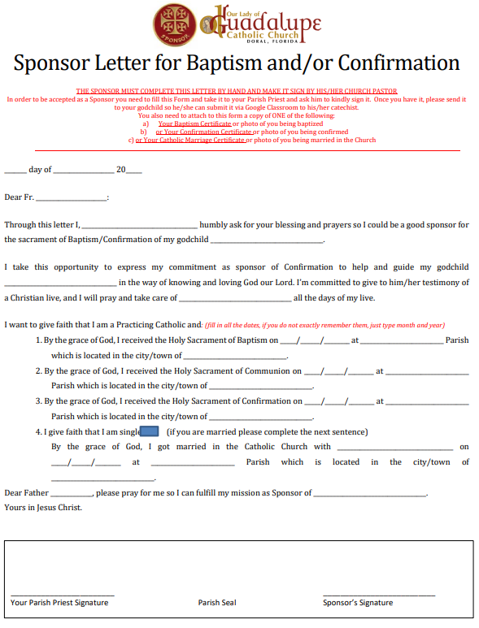
The Sponsor Letter Documents the SPONSORS must SUBMIT BY December 12th
If you want to send the link to the sponsor or if you misplace the forms, please download the forms from the following link
Si ud. desea enviar el enlace al padrino/madrina o no encuentra los formularios, por favor puede bajarlos desde este link:
https://bit.ly/3DdSsnJ
Here you have the list of Documents the Sponsor must submit
A continuación, tiene la lista de los Documentos que el Padrino debe presentar
Sponsor Letter, the sponsor needs to complete it (https://bit.ly/3DdSsnJ)
The Sponsor need to attach a Copy of either his/her
Certificate of Baptism OR
Confirmation OR
Marriage of the Sponsor (one of them) OR
A picture of him/her receiving any of these sacraments
Certificate of Attendance to the Pre-Baptismal Class (https://bit.ly/3TSPHy5)

Slide 32
Requisitos para ser Padrinos de Confirmacion
Este texto ha sido tomado del Código de Derecho Canónico de la Iglesia Católica. Para leerlo en línea por favor haga clic aquí.
872 En la medida de lo posible, a quien va a recibir el bautismo se le ha de dar un padrino, cuya función es asistir en su iniciación cristiana al adulto que se bautiza, y, juntamente con los padres, presentar al niño que va a recibir el bautismo y procurar que después lleve una vida cristiana congruente con el bautismo y cumpla fielmente las obligaciones inherentes al mismo.
873 Téngase un solo padrino o una sola madrina, o uno y una.
874 § 1. Para que alguien sea admitido como padrino, es necesario que:
2. haya cumplido dieciséis (16) años, a no ser que el Obispo diocesano establezca otra edad, o que, por justa causa, el párroco o el ministro consideren admisible una excepción;
3. sea católico, esté confirmado, haya recibido ya el santísimo sacramento de la Eucaristía y lleve, al mismo tiempo, una vida congruente con la fe y con la misión que va a asumir;
4. no esté afectado por una pena canónica, legítimamente impuesta o declarada;
5. no sea el padre o la madre de quien se ha de bautizar.
874 § 2. El bautizado que pertenece a una comunidad eclesial no católica sólo puede ser admitido junto con un padrino católico, y exclusivamente en calidad de testigo del bautismo.
1. haya sido elegido por quien va a bautizarse o por sus padres o por quienes ocupan su lugar o, faltando éstos, por el párroco o ministro; y que tenga capacidad para esta misión e intención de desempeñarla;

Slide 33
Requirements for Godparents of Confirmation
This text was taken from the Cannon Law of the Catholic Church. If you want to read it online, please click here.
Can. 872 Insofar as possible, a person to be baptized is to be given a sponsor who assists an adult in Christian initiation or together with the parents presents an infant for baptism. A sponsor also helps the baptized person to lead a Christian life in keeping with baptism and to fulfill faithfully the obligations inherent in it.
Can. 873 There is to be only one male sponsor or one female sponsor or one of each.
Can. 874 §1. To be permitted to take on the function of sponsor a person must:
2. have completed the sixteenth year of age, unless the diocesan bishop has established another age, or the pastor or minister has granted an exception for a just cause;
3. be a Catholic who has been confirmed and has already received the most holy sacrament of the Eucharist and who leads a life of faith in keeping with the function to be taken on;
4. not be bound by any canonical penalty legitimately imposed or declared;
5. not be the father or mother of the one to be baptized.
Can. 874 §2. A baptized person who belongs to a non-Catholic ecclesial community is not to participate except together with a catholic sponsor as a Christian Witness of the Baptism
Catholic sponsor and then only as a witness of the baptism.
1. be designated by the one to be baptized, by the parents or the person who takes their place, or in their absence by the pastor or minister and have the aptitude and intention of fulfilling this function;

Slide 34


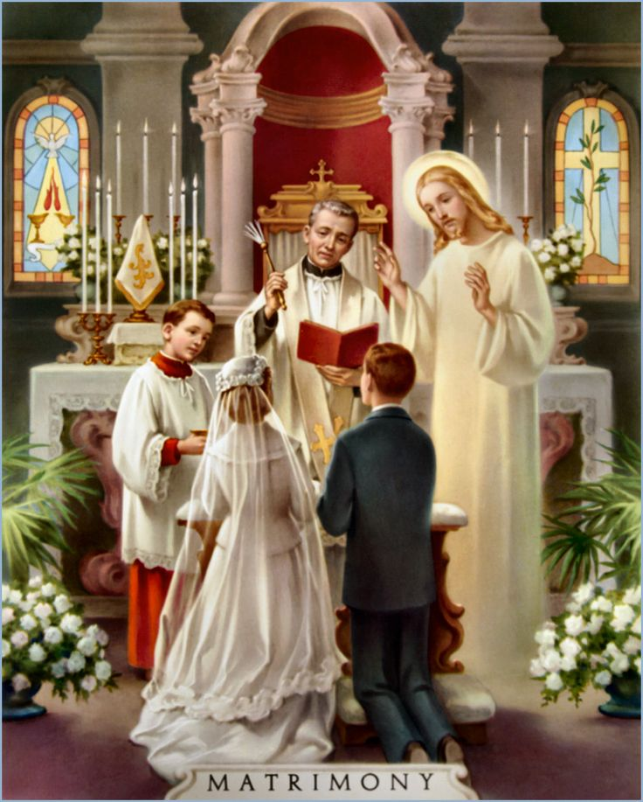


In Summary
WHO CAN BE A SPONSOR?
A Catholic Baptized person
Who Received the Sacraments of
First Communion & Confirmation
Who is Single or…
Married in the Catholic Church

Slide 35
PROXY
If the Sponsor can’t be present the day of the Confirmation
Any Sponsor, who is unable to attend the baptism/confirmation should have a proxy represent him/her at the celebration in their place. The name of the Sponsor will appear on the child's baptismal/confirmation certificate.
Parents just need to inform our Parish Office that the Sponsor will not be able to be present by e-mail to Miguel.ruiz@guadalupedoral.org
WHO CANNOT BE A SPONSOR?
A non-baptized person cannot act as a Sponsor.
A single person who is not married but cohabitating with someone is not permitted to serve as a sponsor.
Cannot be the father or mother of the one to be baptized.
A baptized person who belongs to a non-Catholic ecclesial community is not to participate except together with a Catholic sponsor and then only as a witness to the baptism, but not to confirmation.

Slide 36

Special Activities

Slide 37

Doral Academy: Sunday October 26 8:30 AM & 10:15 AM @ Doral Academy Shelton Academy & RCIA Groups: Monday February 9th @ Parish Hall, Regular Class Time Monday February 9th @ Shelton, Regular Class Time Tuesday February 10th & Wednesday February 11th @ Shelton, Regular Class Time

Slide 38

Doral Academy – Eucharistic Procession:
Sunday February 8, 2026 8:30 AM & 10:15 AM @ Doral Academy
Shelton Academy & RCIA Monday – Eucharistic Adoration (we will do it @ Our Parish Temple)
Shelton Monday February 9th @ 5:30 PM RCIA Monday February 9th @ 7:30 PM Shelton Tuesday February 10th @ 5:30 PM Shelton Wednesday February 11th @ 5:30 PM

Slide 39


Confirmation Retreat & Rehearsal
In order to help our students, we will have the retreat & the rehearsal on the same day.
Para poder ayudar a nuestros estudiantes, tendremos el retiro y el ensayo el mismo día.
March 7th, 2026
from 9:00 am to 1:00 pm for 7th, 8th , 9th Graders
from 2:30 to 6:30 pm for 10th, 11th , 12th Graders
May 11th, 2026
from all RCIA Adult Candidates
from 7:00 pm to 8:30 pm

Slide 40

End of Year Retreat for Parents & Students
Doral Academy:
Sunday May 3rd, 2026
Shelton Academy:
Monday May 4th Tuesday May 5th Wednesday May 6th, 2026

Slide 41
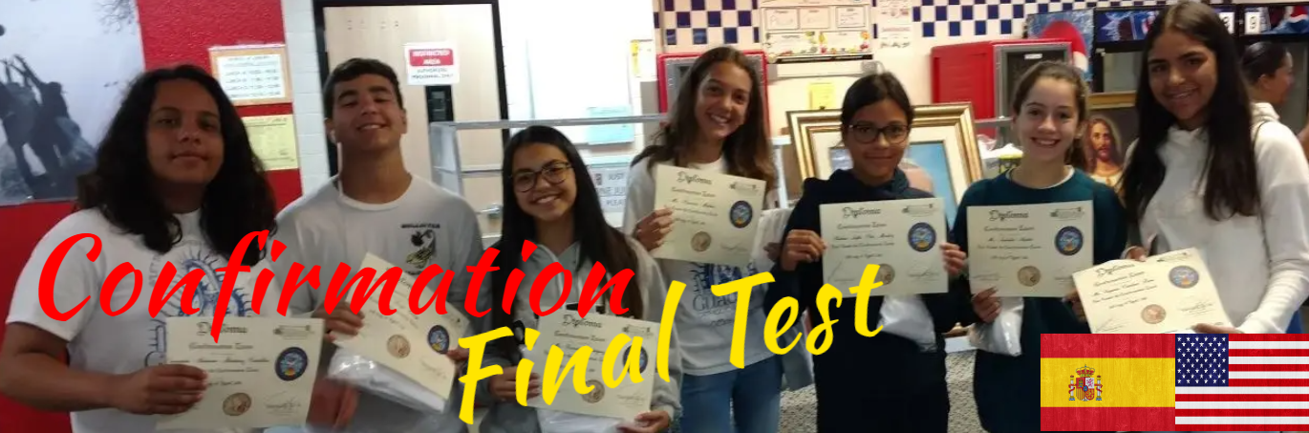
The Final Exam will be online, Using the Parish Google Classroom
Please visit this page for more information
www.guadalupedoral.info/confirmation-page/confirmation-exam-mandatory/

Slide 42

Quizlet
Now you have our Handbook for Confirmation in Quizlet.
Using it will help you to study faster and learn the key elements of the Confirmation Exam
Quizlet English: https://quizlet.com/join/E5tgT2Y5S
Ahora tienes el Handbook de Confirmacion en Quizlet.
Usando esta herramienta podrás estudiar más rápido y podrás aprender los elementos claves del Examen de Confirmación.
Quizlet Spanish: https://quizlet.com/join/rQFyDM3EC

Slide 43


Dress Code

Slide 44
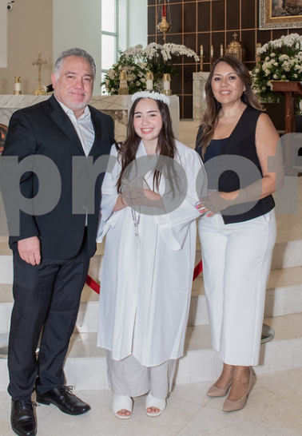
Dress Code for the Confirmation Mass
For Girls
Confirmation White gown
Formal dress / Vestido de salir
Formal shoes (no sneakers)/Zapatos de vestir (No tenis)
Simple Hair style in a pony tale/ Peinado Sencillo al estilo de una cola de caballo
Please remember that Archbishop will SIGN your forehead with Holy Oil… please use a simple hair style to keep your hair free from your forehead.
DO NOT WEAR HIGH HEELS… PLEASE… PLEASE / por favor NO USEN TACONES ALTOS…

Slide 45
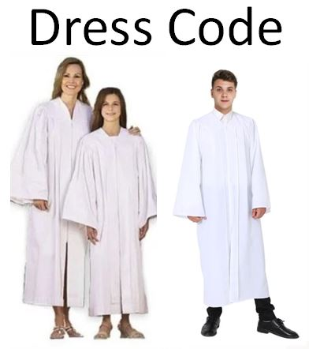
For the Confirmation Mass
For Boys
Confirmation White gown
White long sleeve shirt /Camisa blanca de mangas largas
Black Pants / Pantalón azul o negro
Red Tie / Corbata Roja
Dark dress shoes (no sneakers)/ Zapatos Oscuros (no tenis)

Slide 46
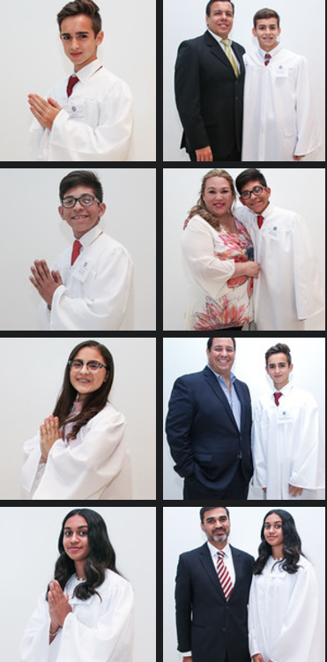
For Parents and Sponsors
For the Confirmation Mass
Mass attire, Dress modestly and tastefully, we suggest to wear suite/tie for men and formal dress for women.
REMEMBER that we will be attending a mass with the Archbishop of Miami, and it will be the Confirmation Mass of your child…
We suggest NO JEANS, NO SNEAKERS.

Slide 47

Confession
Communion
Confirmation
Day

Slide 48
Confession Day May 14, 2026 @ 600 PM First Communion TBA @ AM Confirmation TBA @ AM

Slide 49
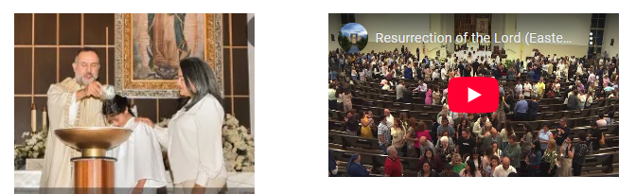
Photo & Video
All the information will be available by November 1st in this link:
www.guadalupedoral.info/forparents/photography/

