Slide 1


Slide 2


OPEN HOUSE 2025-2026
Special Celebrations & Dates of
Holy Baptism, Communion and Confirmation
for
RCIA-Children
RCIA-Teenagers
RCIA-Adults
Parish WhatsApp # 786-309-3387 (no calls)
Parish E-Mail: Miguel.ruiz@guadalupedoral.org
Parish Website: www.guadalupedoral.info

Slide 3
Special Points
To better understand the Program

Slide 4
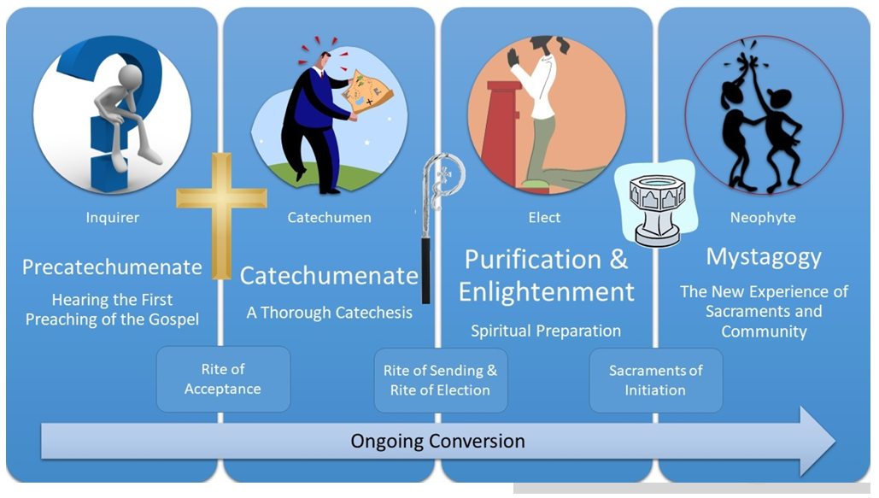
OPEN HOUSE for for OCIA-Children OCIA-Teenagers OCIA-Adults
First Step:
Precatechumenate: From September 2025 to December 2026 Big Ceremony: Welcome to the Catholic Church (1st week of Dec)
Second Step:
Catechumenate: From December 2025 to February 2026
Big Ceremony: The Book of the Elect (2nd week of February)
Third Step:
Purification: February 2026 to Palm Sunday, 2026
Big Ceremonies: The 3 Scrutinies
Fourth Step:
Mystagogy: From April 2026 until you enter in Heaven Big Ceremony: Baptism, Communion, Confirmation and Confession

Slide 5

Asistencia a Misa
Keep holy the Lord’s day is the 3rd Commandment
We must attend Mass every Sunday.
We must attend Mass in Person
In our Parish of Guadalupe
Or in any Catholic Parish
MASS ATTENDANCE LOG
Watch this Video/Vean este Video
www.guadalupedoral.info/mass-attendance-log/
You will get these messages every week through your Google Classroom
Recibirán estos mensajes semanalmente en Google Classroom

Slide 6
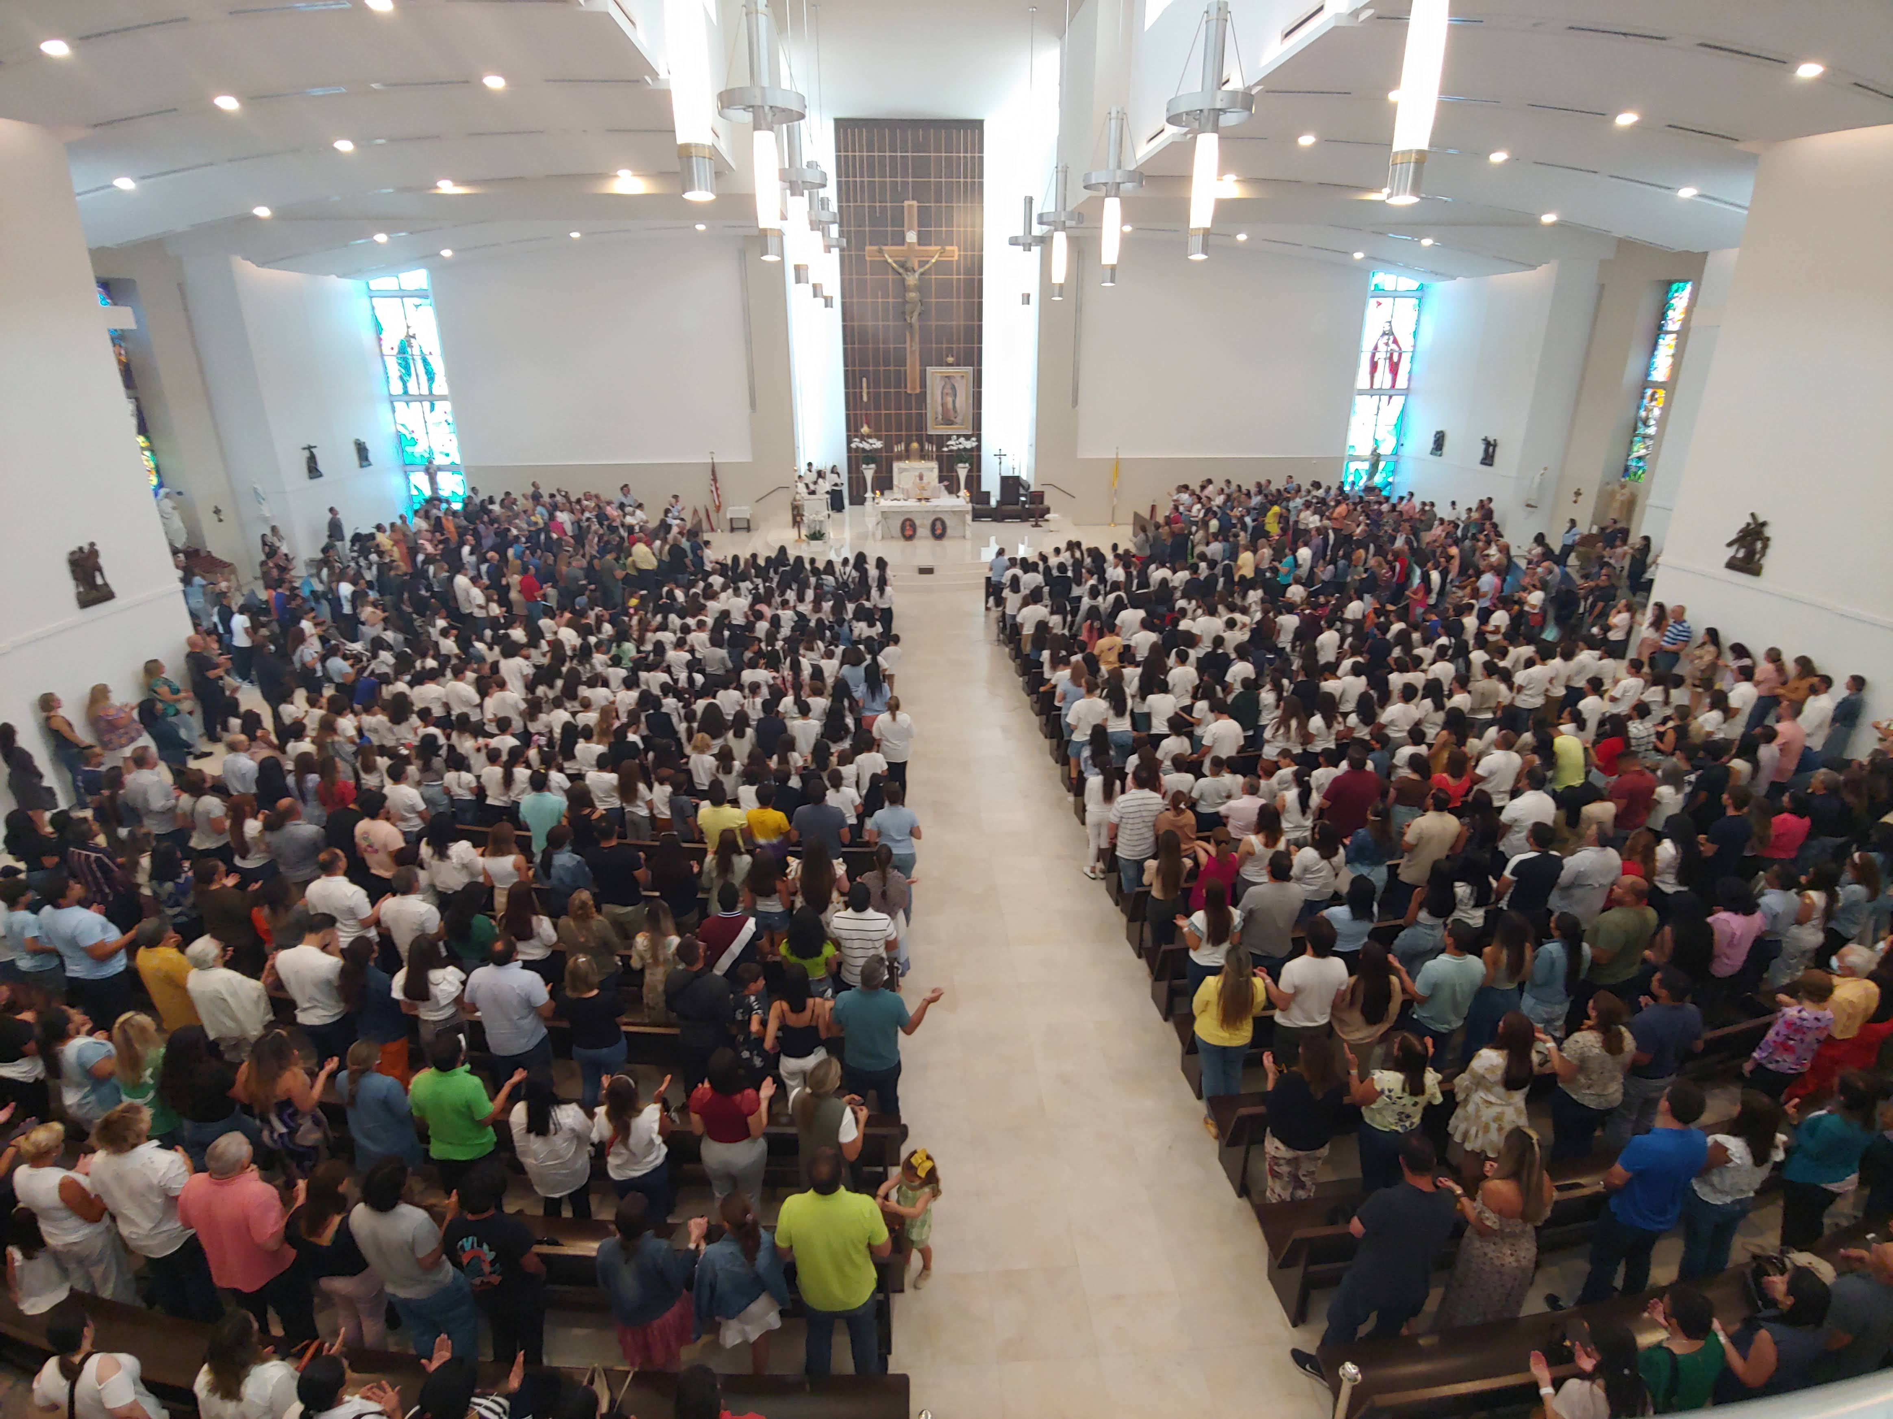
First Mass and Blessing for all our Students
Saturday 09/13 | 5:30 pm | English
 | 7:00 pm | Español
Sunday 09/14 | 8:30 am | English
 | 10:00 am | Español
 | 11:45 am | English
 | 1:30 pm | Español
 | 7:00 pm | Español

Slide 7


Class Attendance
NO LATE ARRIVAL: LOS NINOS DEBEN ESTAR SENTADOS AL MOMENTO DE COMENZAR, LA CLASE, Si llegan tarde no podrán ingresar al salón. STUDENTS MUST BE AT THEIR DESK ON TIME, if they arrive late, they will NOT be able to enter in the classroom
NO EARLY RELEASE: Students are not permitted to leave class early except in emergency situations. Sports practice, dance class, etc. are not considered emergencies. No se permite a los estudiantes salir de clase antes de tiempo, excepto en situaciones de emergencia. Las prácticas deportivas, las clases de baile, etc., no se consideran emergencias
MAXIMUM OF ABSENCES: Se puede faltar hasta 4 veces en el año
They may be absent up to 4 times in a year
EXCUSE ABSENCE: Se debe enviar por e-mail el justificativo de la inasistencia. Se debe notificar al catequista y a la Oficina de la Parroquia y al Catequista. Las prácticas deportivas, las clases de baile, etc., no se consideran ausencias justificables.
You must send via e-mail a Justification Note to your catechist and to the Office of Catechesis. Sports practice, dance class, etc. are not considered an excuse absence. (ccd@guadalupedoral.org) & (your catechist e-mail)
Check your catechist Email in this link www.guadalupedoral.info/forcatechists/our-team/

Slide 8
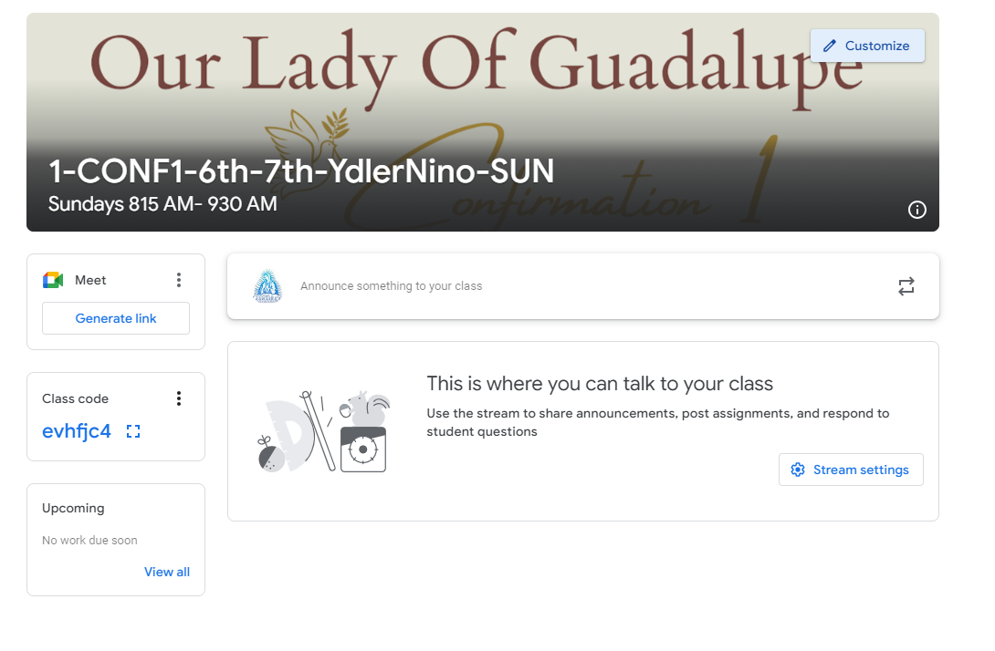
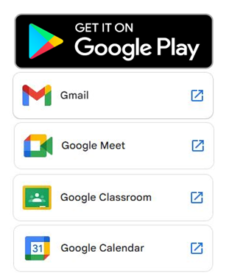

Google Classroom
We will use the Google Classroom as a method of communication. Please log to your Google Classroom account every Friday or Saturday to see any news
Usaremos Google Classroom como metodo de comunicacion. Por favor visiten su cuenta de Google Classroom todos los Viernes o Sabados para ver si hay alguna noticia
GOOGLE CLASSROOM
Login with your parish email / Haga login con el e-mail de la parroquia
a. Username: name.lastname@guadalupedoral.org
b. Password: ****** (the one you selected – el que uds. seleccionaron)
The email account and the google classroom account have the same password / El Email de la parroquia y el google classroom tiene el mismo password
www.classroom.google.com/u/0/h

Slide 9
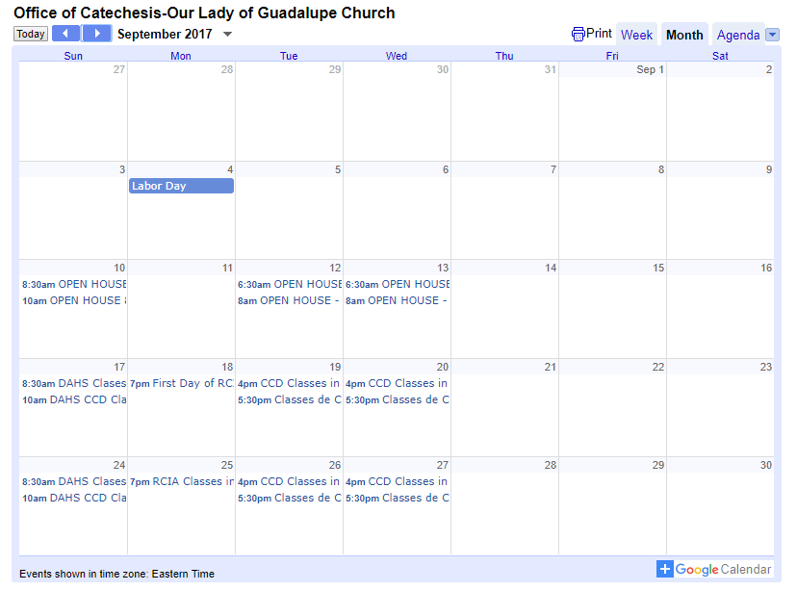
Calendario / Calendar
From your cellphone subscribe to our calendar by clicking over the +Google Calendar Icon that is at the bottom right corner of the online calendar and follow the instructions.
You might need to download the Google Calendar application.
Desde su celular suscríbase a nuestro calendario haciendo click sobre el +Google Calendar que está en la esquina inferior derecha del calendario electrónico y siga las instrucciones.
Tal vez tenga que bajar la aplicación Google Calendar.
The Official Calendar is posted in our website
http://guadalupedoral.info/calendar/ and download the Calendar
2025-2026
CCD Calendar

Slide 10

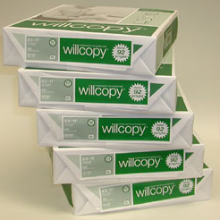
Material / School Supplies
For elementary school students
1- A composition notebook
2- Pencil case, zippered
3- A box of Crayons
4- Pair of blunt scissors
5- A sharpened pencil and an erase
6 A jumbo glue stick
7- 1 reams of paper - A DONATION (if you can)
For middle and high school students & RCIA
A composition notebook
A sharpened pencil, a pen, and an eraser
1 reams of paper - A DONATION (if you can)

Slide 11
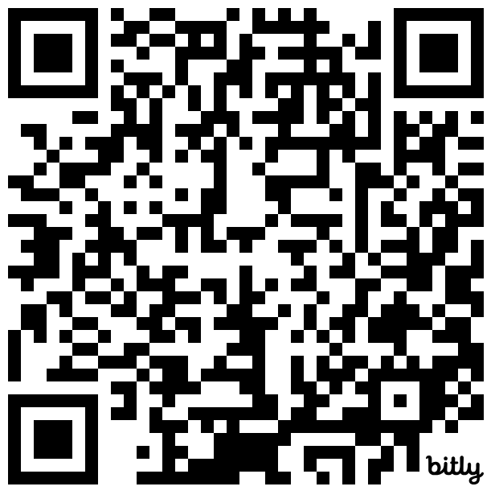


Slide 12
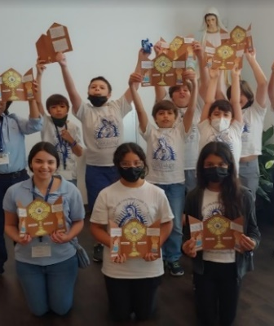
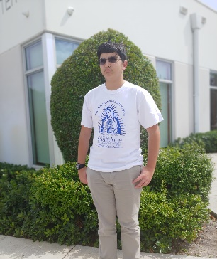
Uniform
Blue, Kaki or Jeans pants or skirts
Our Lady of Guadalupe T-Shirt
ID Tag

Slide 13

Classes of Formation for Parents
This year we will provide Classes of Catholic Formation for Parents.
Classes will be given at the same time than the kids’ classes. Este año brindaremos Clases de Formación Católica para Padres.
Las clases se darán al mismo tiempo que las clases de los niños.

Slide 14

Special Ceremonies
Key dates

Slide 15
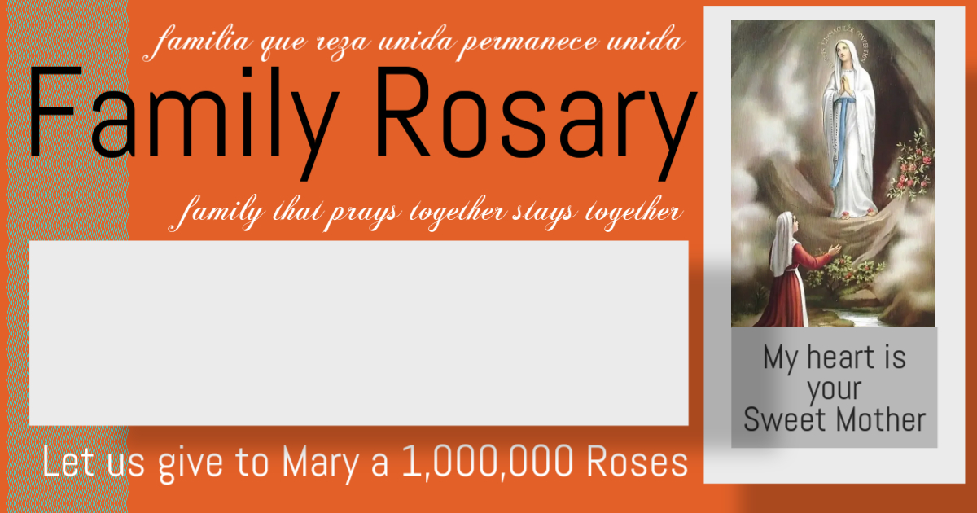
Doral Academy: Sunday October 26 8:30 AM & 10:15 AM @ Doral Academy Parish Hall: Monday October 27 7:00 PM @ Parish Hall

Slide 16
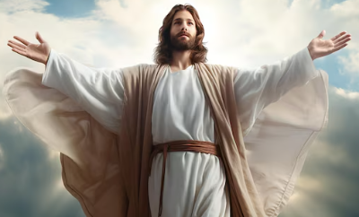
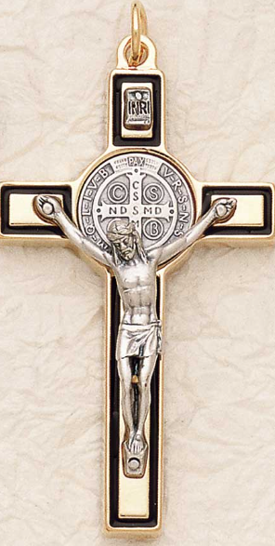
Rite of Acceptance into the Order of the Catechumens
Saturday December 6th, 2025 @ 5:00 PM
at Our Lady of Guadalupe Parish Temple
11691 NW 25 Street, Doral, Florida 33172
Attendees: For candidates,
(and 3 guests, father, mother and the sponsor)
Purpose of this meeting: This is a very important ceremony in which the candidate will be officially welcomed into our Parish Community and officially accepted into the Order of the Catechumens, which is a special group of people who have expressed their desire to become Catholics and wish to be Baptized.
Dress Code for this Ceremony Ladies/Girls wear the Our Lady of Guadalupe T-Shirt.
No snickers. No high hills.
Gentlemen/Boys wear the Our Lady of Guadalupe T-Shirt.
No snickers.
Parents and Godparents, formal dress

Slide 17

Doral Academy:
Sunday February 8, 2026 8:30 AM & 10:15 AM @ Doral Academy
Shelton Academy (we will do it @ Our Parish Temple)
Monday February 9th @ 5:30 PM Tuesday February 10th @ 5:30 PM Wednesday February 11th @ 5:30 PM

Slide 18
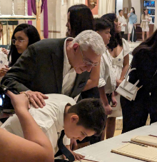

Rite of Election
February 22, 2026
(@ 500 PM to be confirmed)
at St. Mary Cathedral 7225 NW 2nd AVE, Miami, Florida 33150
Attendees: For candidates, Sponsor & Parents (no guests)
Purpose of this meeting: This Ceremony is very important. On this day the candidates will be personally welcomed by Archbishop Wenski, the Archbishop of Miami. In his presence the candidates will write their names in the Book of the Elected, which is a special book kept at the Cathedral of Miami and symbolizes the Heart of God, the spiritual meaning of this ceremony is that “the candidate’s name is now written in the very Heart of God”.
Dress Code Ladies/Girls wear a white dress. No gowns, No high hills.
Gentlemen/Boys wear black or blue pants with a white shirt and tie. No gowns, No snickers.
Parents and Godparents, formal dress

Slide 19
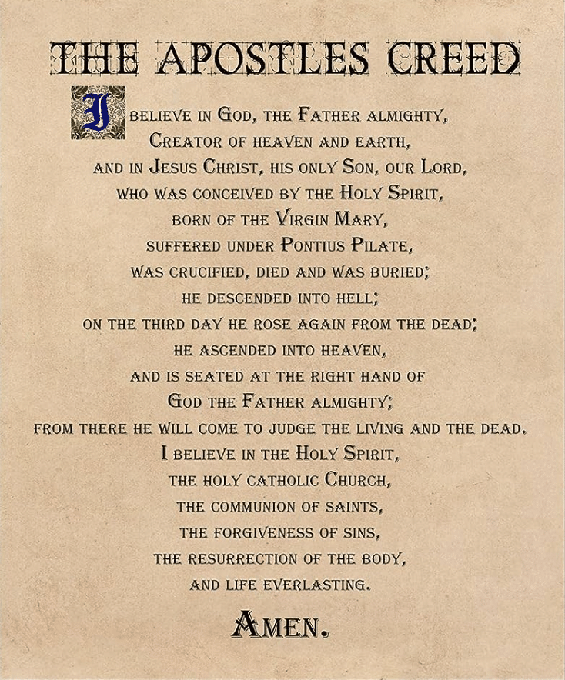
First Scrutiny (The Creed)
Saturday, February 28, 2026 @ 5:00 PM
in Our Lady of Guadalupe 11691 NW 25 Street, Doral, Florida 33172
Attendees: For candidates, parents and Godparents (if Godparents are not able to be present, you will need to select somebody who will represent them at the ceremony)
Purpose of this meeting: On this ceremony, the candidate will ‘publicly professes his/her faith in our Lord Jesus” that is why they will pray The Creed with the priest. The entire Parish Community will join them and pray for them, so they can be lawful children of God.
Dress Code:
Ladies/Girls wear a white dress. No gowns, No high hills.
Gentlemen/Boys wear black or blue pants with a white shirt and tie. No gowns, No snickers.
Parents and Godparents, formal dress

Slide 20
Rehearsal of the Baptism, First Communion & Confirmation
Saturday Marzo 14, 2026 @ 3:30 PM
in Our Lady of Guadalupe Parish Temple 11691 NW 25 Street, Doral, Florida 33172
Attendees: For candidates, parents and Godparents (if Godparents are not able to be present, you will need to select somebody who will represent them at the ceremony)
Purpose of this meeting This is a very important rehearsal in which the candidate will be practicing the things they will be doing during the Holy Mass of Baptism.

Slide 21
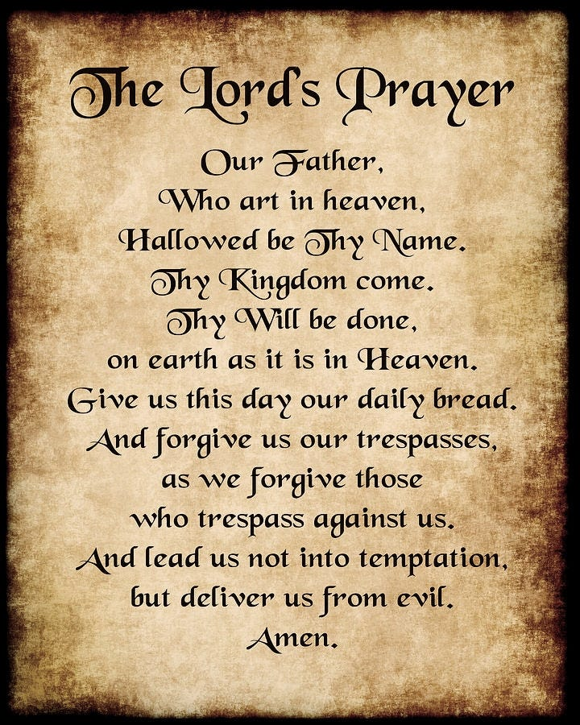
Second Scrutiny (The Lord’s Prayer)
Saturday, March 14th, 2026 @ 5:00 PM
in Our Lady of Guadalupe 11691 NW 25 Street, Doral, Florida 33172
Attendees: For candidates, parents and Godparents (if Godparents are not able to be present, you will need to select somebody who will represent them at the ceremony)
Purpose of this meeting: On this ceremony, the candidate will ‘publicly pray for first time the Our Father” and publicly will accept the gift of being a Child of God. The entire Parish Community will join them and pray for them, so they can be faithful children of God.
Dress Code:
Ladies/Girls wear a white dress. No gowns, No high hills.
Gentlemen/Boys wear black or blue pants with a white shirt and tie.
No gowns, No snickers.
Parents and Godparents, formal dress

Slide 22

Third Scrutiny (Palm Sunday)
Saturday, March 28, 2026 @ 5:00 PM
in Our Lady of Guadalupe 11691 NW 25 Street, Doral, Florida 33172
Attendees: For candidates, parents and Godparents (if Godparents are not able to be present, you will need to select somebody who will represent them at the ceremony)
Purpose of this meeting: On this ceremony, the candidate will ‘publicly profess that Jesus is the Son of God”.
Dress Code
Ladies/Girls wear the gown, No high hills.
Gentlemen/Boys wear the gowns, No snickers.
Parents and Godparents, formal dress.

Slide 23
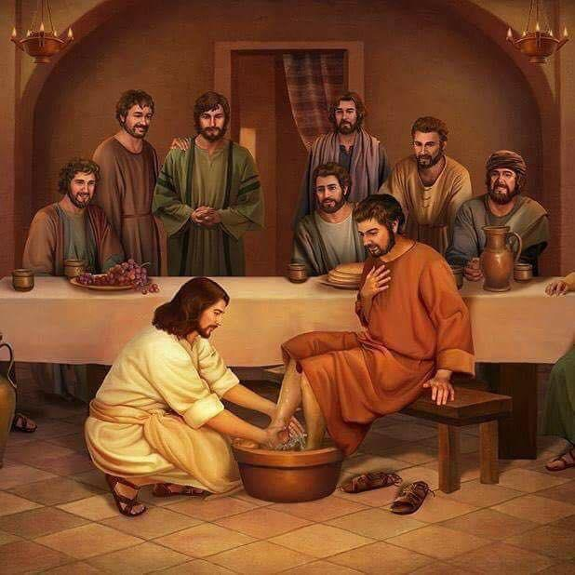
Holy Thursday (The Last Supper)
Thursday, April 17, 2026
@ 8:00 PM
in Our Lady of Guadalupe 11691 NW 25 Street, Doral, Florida 33172
Dress Code
Ladies/Girls wear the gown, No high hills.
Gentlemen/Boys wear the gowns, No snickers.
Parents and Godparents, formal dress.

Slide 24
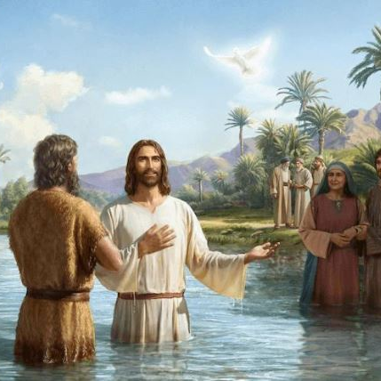
Baptism, Communion & Confirmation Saturday, April 4th, 2026
7:00 PM Arrival and Preliminary Rites
8:00 PM in Our Lady of Guadalupe Temple 11691 NW 25 Street, Doral, Florida 33172
Attendees: For candidates, parents and Godparents (if Godparents are not able to be present, you will need to select somebody who will represent them at the ceremony)
Purpose of this meeting: On this day, the journey that took two years, will conclude with the reception of the greatest of all the blessings, they will receive Holy Baptism and for the first time, they will receive the Holy Body and Blood of Jesus Christ. They will also receive the gift of the Holy Spirit in the sacrament of the Holy Confirmation.
Dress Code: Ladies & Gentlemen: White gown Parents and Godparents: formal dress

Slide 25
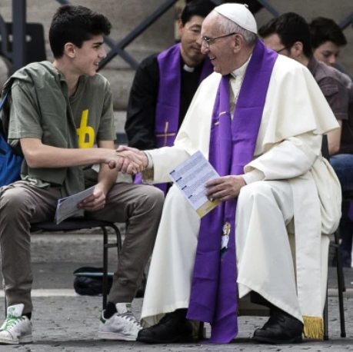
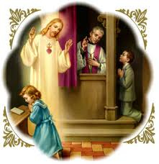
First Confessions
May 15th, 2025 @ 6:00 PM
in Our Lady of Guadalupe Temple 11691 NW 25 Street, Doral, Florida 33172

Slide 26

Spiritual Retreats
1) Elementary School Candidates
February 28 @ TBA
2) Middle & HS School Candidates March 7 @ TBA
3) Adults Candidates May 11 @ 700 PM
in Our Lady of Guadalupe Parish Hall 11691 NW 25 Street, Doral Florida 33172

Slide 27
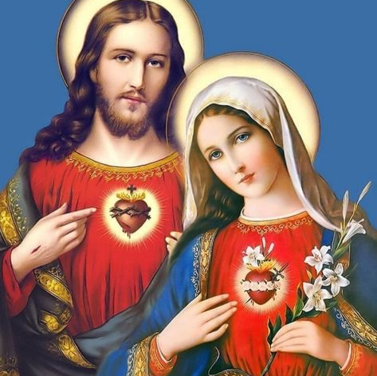
Consecration Mass
Sunday, May 17, 2026
@ 4:00 PM
in Our Lady of Guadalupe 11691 NW 25 Street, Doral, Florida 33172
Dress Code
Ladies/Girls CCD Uniform.
Gentlemen/Boys CCD Uniform.
Parents and Godparents, formal dress.

Slide 28

Documents
The candidate needs to present

Slide 29
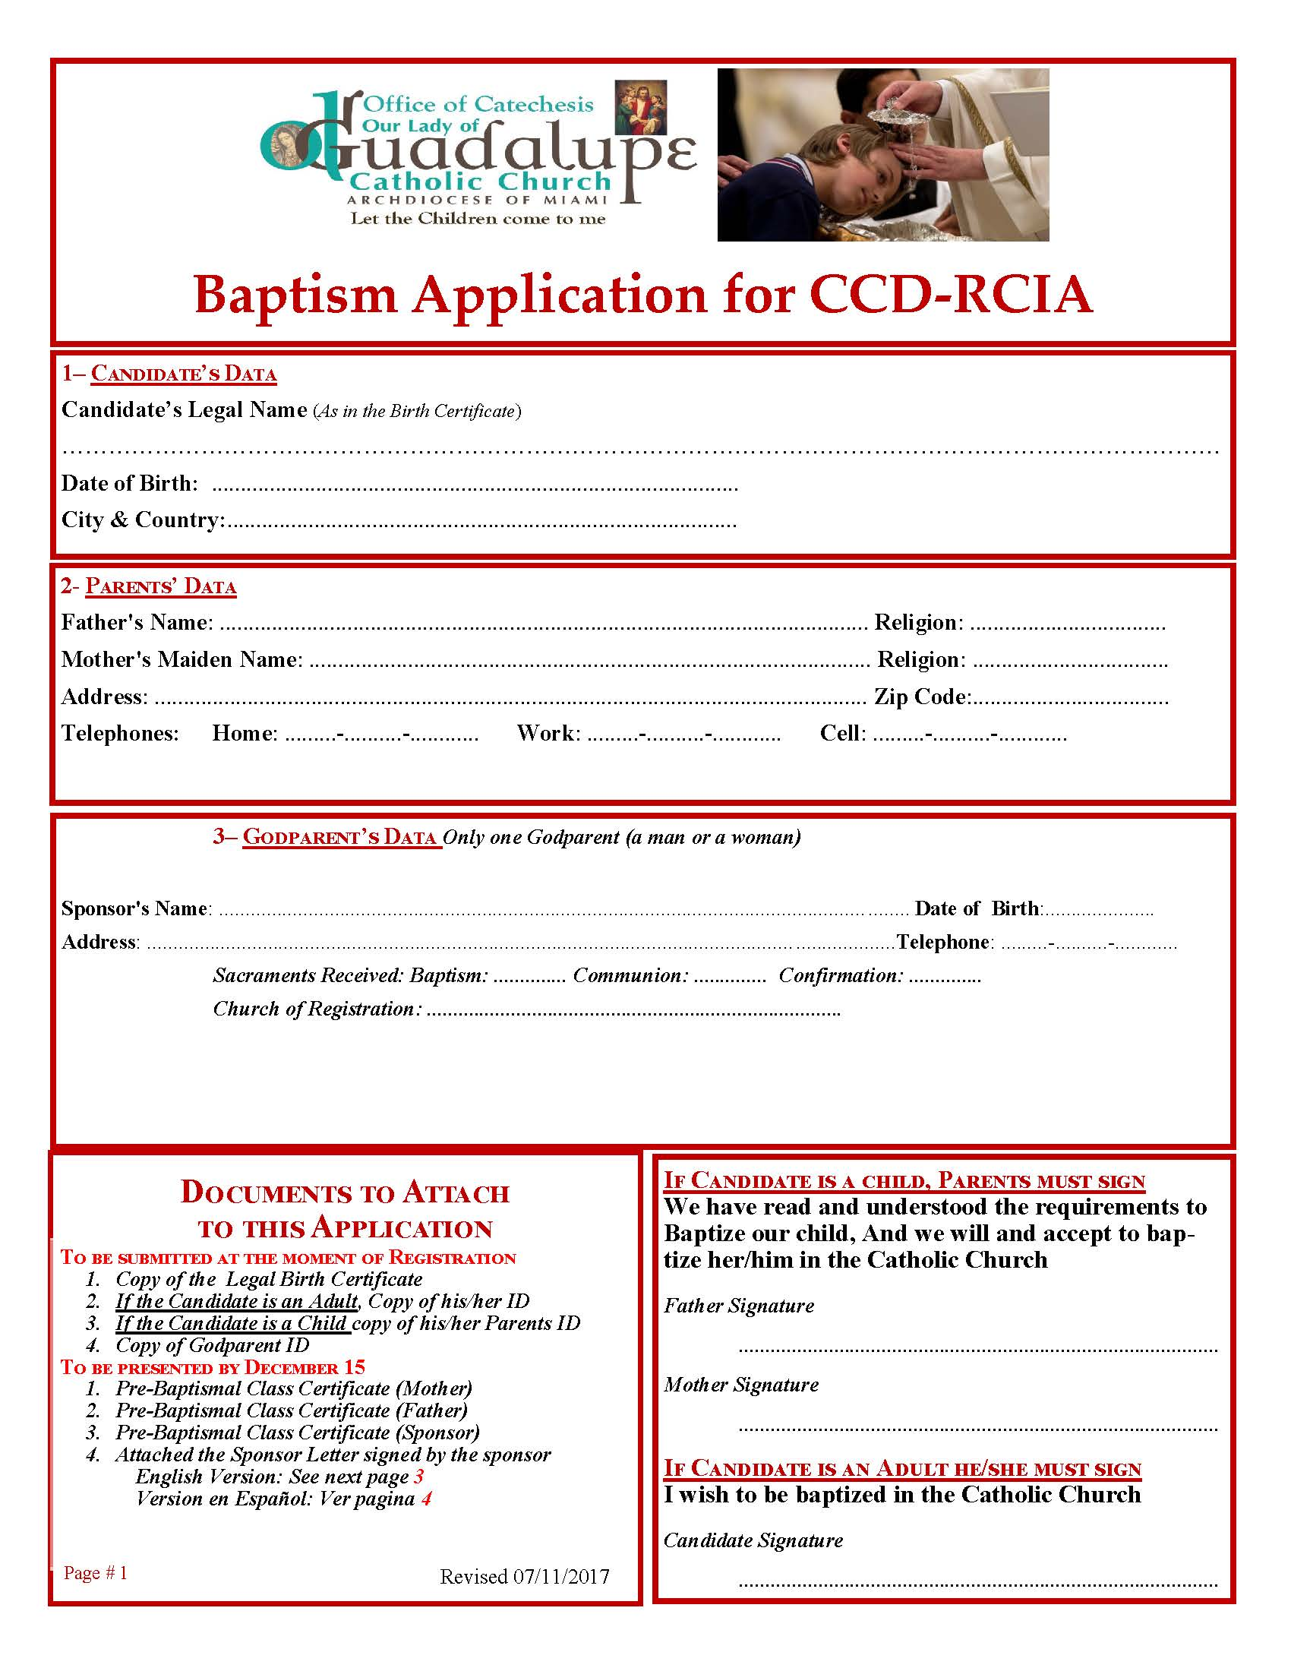
1) Baptism Application
Form
This Document the Candidates
must SUBMIT it BY December 1st
Please send us via email to
ccd@guadalupedoral.org
the following
Send it by December 1st
* Copy of the Legal Birth Certificate
* Copy of Godparent/Sponsor ID or Passport

Slide 30
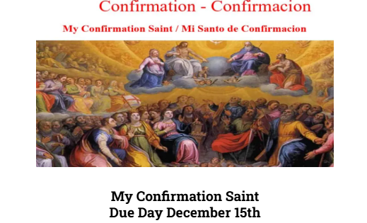
2) The Saint Name Document the Candidates must SUBMIT it BY December 15th
Purpose of this assignment:
When deciding on a Confirmation name, the goal is to choose the name of a saint you admire, can relate to, or aspire to be like. This saint will be bonded to you spiritually and will be your role model in life. They can be the one you turn to for guidance and protection during life’s challenges. Throughout the Bible, there are many examples of people taking on new names, dating back to the Old Testament. God changed the names of many to reflect the special roles they’d play throughout the history of the Church. For example, God changed Abram’s name to Abraham meaning, “father to a host of nations.” This name change signified that God was making a covenant with Abraham that would make him the first of God’s people on earth. Simon’s name was changed to Peter, meaning “rock” and refers to Peter becoming the first pope: “And upon this rock I will build my church” (Matthew 16:17-18)
How to choose a Confirmation Saint?
Boys must choose a Male saint
Girls must choose a Female saint
You may search for your saint name at: www.catholic.org/saints/

Slide 31
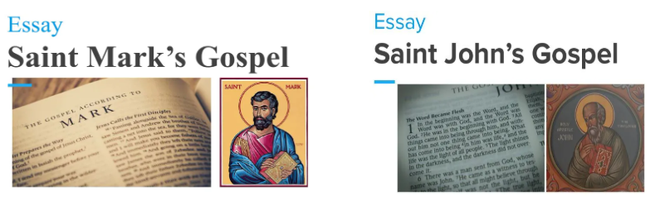
3) Reading of the Gospels
Elementary School Candidates
Only will present the Gospel of St. Mark
Middle School, High School and Adult Candidates They will present St. Mark and St. John Gospel

Slide 32
Documents
The Parents/Sponsors need to present

Slide 33
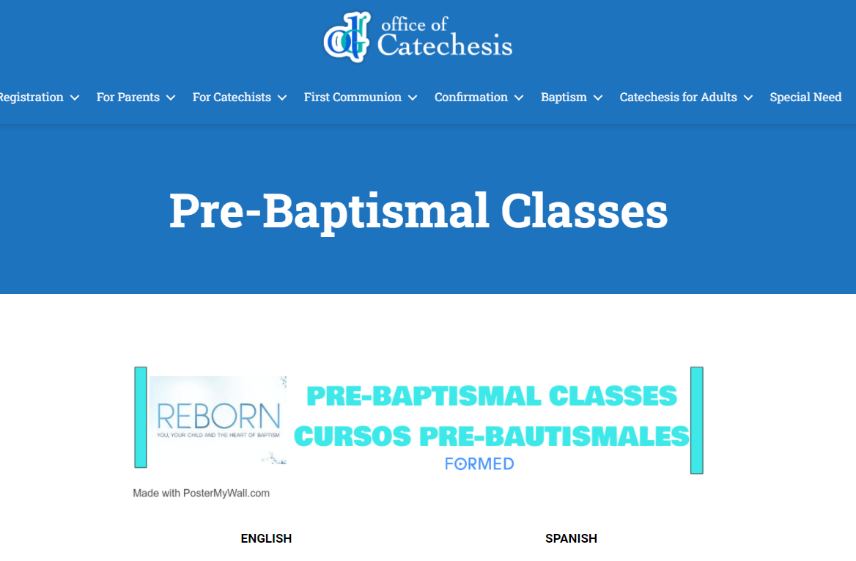
Pre-Baptismal Classes
To Register please visit
www.guadalupedoral.info/pre-baptismal-classes/
Classes must be taken before November 1st

Slide 34
Documents
The Sponsors need to present

Slide 35

Sponsor’s Document
Pre-Baptism Class for Godparents:
MANDATORY.
Online Classes in this Link: https://guadalupedoral.info/pre-baptismal-classes/
They need to take the class before November 1st, 2025.
Send the Certification of completion to miguel.ruiz@guadalupedoral.org
Sponsor Letter
Sponsors must complete and sign the attached Sponsor Letter
Must by submit it by December 12th, 2025, via e-mail your Google Classroom
Los padrinos deben completar y firmar La Carta del Padrino,
deben entregarla antes del 31 de Agosto vía your Google Classroom or via e-mail to miguel.ruiz@guadalupedoral.org
3. Certificate of Baptism OR Confirmation OR Marriage
Sponsors must submit a copy of any of the above certificates, please attach it to the Sponsor letter and send it to miguel.ruiz@guadalupedoral.org
Los padrinos deben entregar una copia de alguno de los certificados arriba mencionados. Por favor adjúntelo al Sponsor Letter y envíelo a miguel.ruiz@guadalupedoral.org
Must by submit it by December 12th, 2025.

Slide 36

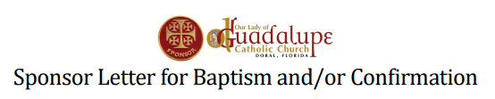
Sponsor’s Document
Pre-Baptism Class for Parents & Godparents: MANDATORY. Must be submitted by November 1st via e-mail your Google Classroom
www.guadalupedoral.info/pre-baptismal-classes/
Sponsor Letter
Sponsors must complete and sign the attached Sponsor Letter Must by submit it by December 12th, 2025, via e-mail your Google Classroom
www.guadalupedoral.info/wp-content/uploads/2021/11/Sponsor-Letter-Bilingual-1.pdf

Slide 37

Sponsor Requirements
Requisitos de los Padrinos

Slide 38
Requirements for Godparents of Baptism
This text was taken from the Cannon Law of the Catholic Church. If you want to read it online, please click here.
Can. 872 Insofar as possible, a person to be baptized is to be given a sponsor who assists an adult in Christian initiation or together with the parents presents an infant for baptism. A sponsor also helps the baptized person to lead a Christian life in keeping with baptism and to fulfill faithfully the obligations inherent in it.
Can. 873 There is to be only one male sponsor or one female sponsor or one of each.
Can. 874 §1. To be permitted to take on the function of sponsor a person must:
2. have completed the sixteenth year of age, unless the diocesan bishop has established another age, or the pastor or minister has granted an exception for a just cause;
3. be a Catholic who has been confirmed and has already received the most holy sacrament of the Eucharist and who leads a life of faith in keeping with the function to be taken on;
4. not be bound by any canonical penalty legitimately imposed or declared;
5. not be the father or mother of the one to be baptized.
Can. 874 §2. A baptized person who belongs to a non-Catholic ecclesial community is not to participate except together with a catholic sponsor as a Christian Witness of the Baptism
Catholic sponsor and then only as a witness of the baptism.
1. be designated by the one to be baptized, by the parents or the person who takes their place, or in their absence by the pastor or minister and have the aptitude and intention of fulfilling this function;

Slide 39
Requisitos para ser Padrinos de Bautismo
Este texto ha sido tomado del Código de Derecho Canónico de la Iglesia Católica. Para leerlo en línea por favor haga clic aquí.
872 En la medida de lo posible, a quien va a recibir el bautismo se le ha de dar un padrino, cuya función es asistir en su iniciación cristiana al adulto que se bautiza, y, juntamente con los padres, presentar al niño que va a recibir el bautismo y procurar que después lleve una vida cristiana congruente con el bautismo y cumpla fielmente las obligaciones inherentes al mismo.
873 Téngase un solo padrino o una sola madrina, o uno y una.
874 § 1. Para que alguien sea admitido como padrino, es necesario que:
2. haya cumplido dieciséis (16) años, a no ser que el Obispo diocesano establezca otra edad, o que, por justa causa, el párroco o el ministro consideren admisible una excepción;
3. sea católico, esté confirmado, haya recibido ya el santísimo sacramento de la Eucaristía y lleve, al mismo tiempo, una vida congruente con la fe y con la misión que va a asumir;
4. no esté afectado por una pena canónica, legítimamente impuesta o declarada;
5. no sea el padre o la madre de quien se ha de bautizar.
874 § 2. El bautizado que pertenece a una comunidad eclesial no católica sólo puede ser admitido junto con un padrino católico, y exclusivamente en calidad de testigo del bautismo.
1. haya sido elegido por quien va a bautizarse o por sus padres o por quienes ocupan su lugar o, faltando éstos, por el párroco o ministro; y que tenga capacidad para esta misión e intención de desempeñarla;

Slide 40


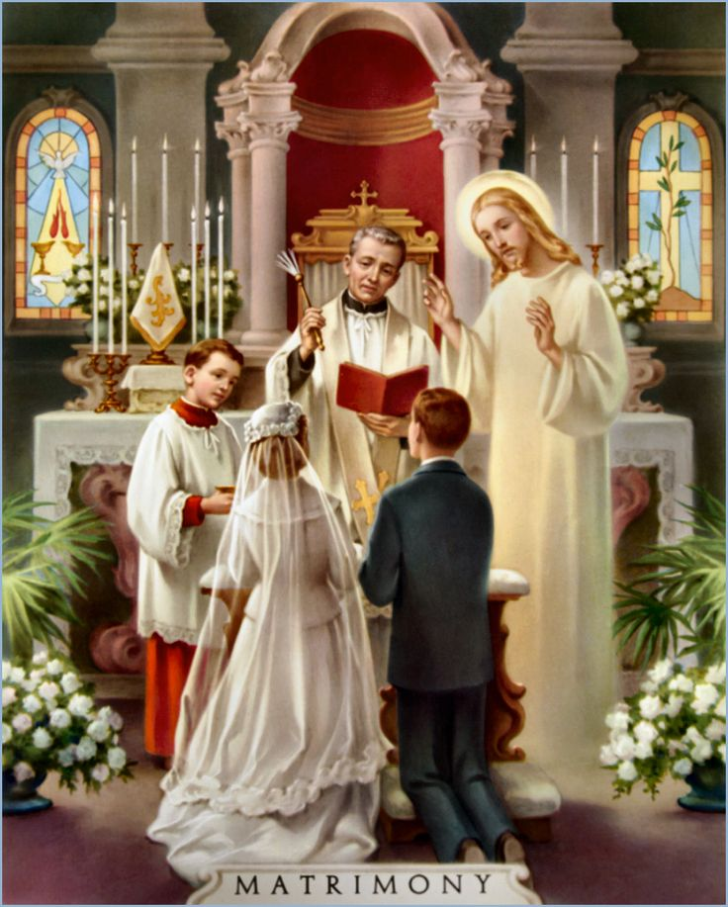


In Summary
WHO CAN BE A SPONSOR?
A Catholic Baptized person
Who Received the Sacraments of
First Communion & Confirmation
Who is Single or…
Married in the Catholic Church

Slide 41
PROXY
If the Sponsor can’t be present the day of the Confirmation
Any Sponsor, who is unable to attend the baptism/confirmation should have a proxy represent him/her at the celebration in their place. The name of the Sponsor will appear on the child's baptismal/confirmation certificate.
Parents just need to inform our Parish Office that the Sponsor will not be able to be present by e-mail to Miguel.ruiz@guadalupedoral.org
WHO CANNOT BE A SPONSOR?
A non-baptized person cannot act as a Sponsor.
A single person who is not married but cohabitating with someone is not permitted to serve as a sponsor.
Cannot be the father or mother of the one to be baptized.
A baptized person who belongs to a non-Catholic ecclesial community is not to participate except together with a Catholic sponsor and then only as a witness to the baptism, but not to confirmation.

Slide 42
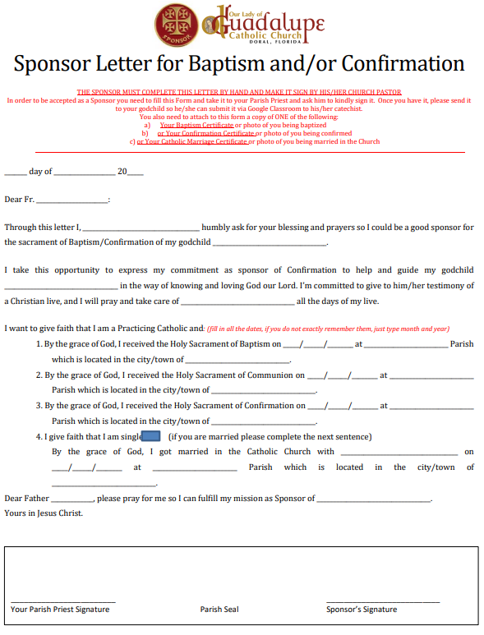
The Sponsor Letter Documents the SPONSORS must SUBMIT BY December 12th
If you want to send the link to the sponsor or if you misplace the forms, please download the forms from the following link
Si ud. desea enviar el enlace al padrino/madrina o no encuentra los formularios, por favor puede bajarlos desde este link:
https://bit.ly/3DdSsnJ
Here you have the list of Documents the Sponsor must submit
A continuación, tiene la lista de los Documentos que el Padrino debe presentar
Sponsor Letter, the sponsor needs to complete it (https://bit.ly/3DdSsnJ)
The Sponsor need to attach a Copy of either his/her
Certificate of Baptism OR
Confirmation OR
Marriage of the Sponsor (one of them) OR
A picture of him/her receiving any of these sacraments
Certificate of Attendance to the Pre-Baptismal Class (https://bit.ly/3TSPHy5)

Slide 43
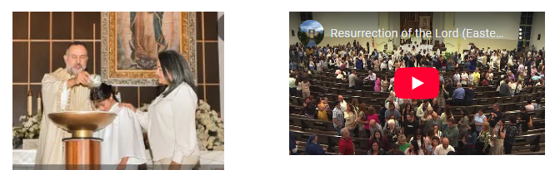
Photo & Video
All the information will be available by November 1st in this link:
www.guadalupedoral.info/forparents/photography/

